Slide 1
COSC 4370 Fall 2023 Interactive Computer Graphics M & W 5:30 to 7:00 PM
Prof. Victoria Hilford
PLEASE TURN your webcam ON
NO CHATTING during LECTURE

Slide 2
COSC 4370
5:30 to 7
PLEASE
LOG IN
CANVAS
Please close all other windows.

Slide 3
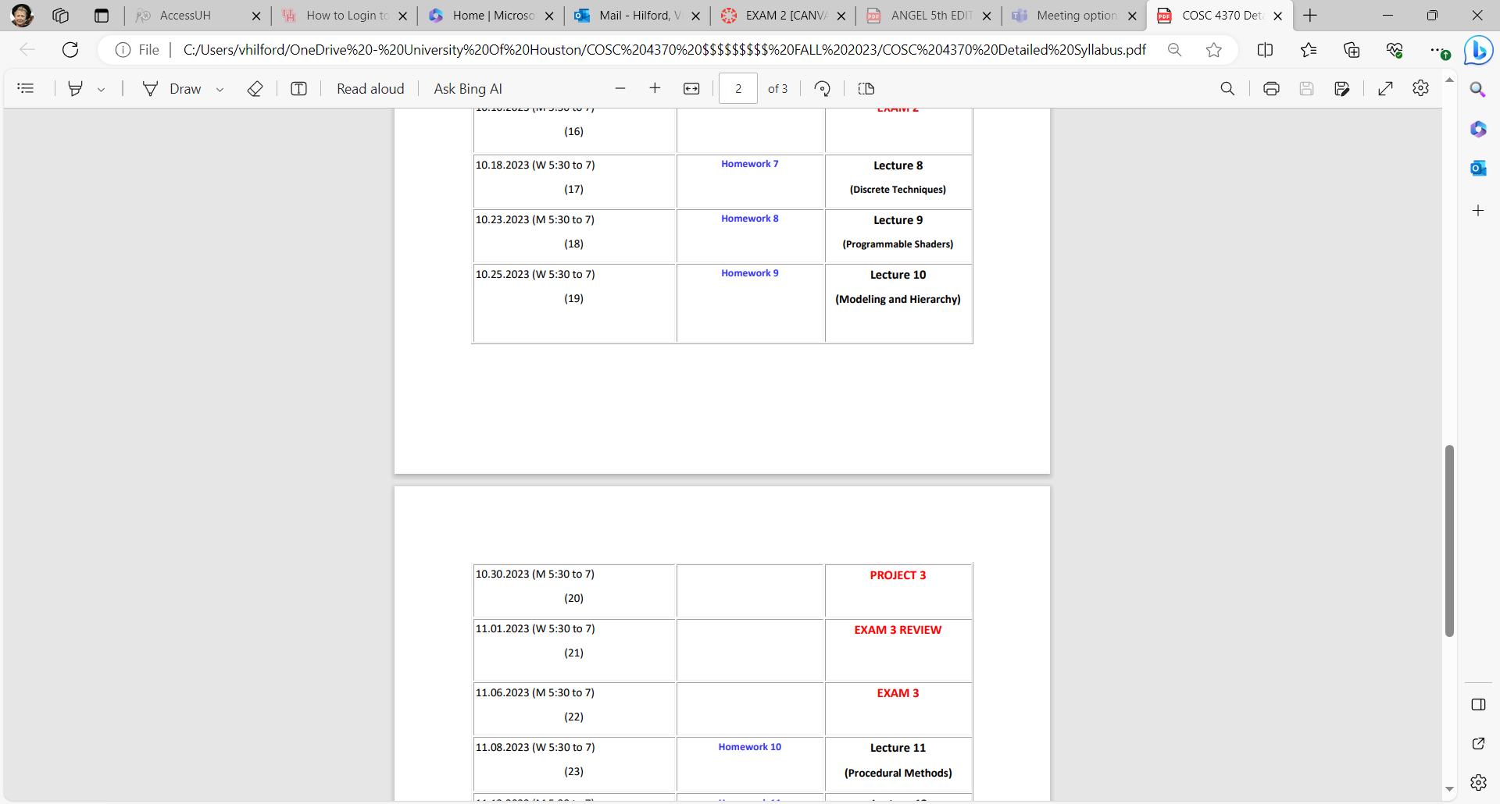
NEXT.

Slide 4
Lecture 10 Modeling and Hierarchy Chapter 10
COSC 4370 – Computer Graphics
Notes:
Models are abstractions of the world both of the real world in which we live and of virtual worlds that we create with computers.
We are all familiar with mathematical models that are used in all areas of science and engineering. We go through analogous processes in computer graphics, choosing which primitives to use in our models and how to show relationships among them.
Often, as is true of choosing a mathematical model, there are multiple approaches, so we seek models that can take advantage of the capabilities of our graphics systems.
In this chapter, we explore multiple approaches to developing and working with models of geometric objects.
We consider models that use as building blocks a set of simple geometric objects: either the primitives supported by our graphics systems or a set of user- defined objects built from these primitives.
We extend the use of transformations from Chapter 4 to include hierarchical relationships among the objects.
The techniques that we develop are appropriate for applications, such as robotics and figure animation, where the dynamic behavior of the objects is characterized by relationships among the parts of the model. The notion of hierarchy is a powerful one and is an integral part of object-oriented methodologies.
We extend our hierarchical models of objects to hierarchical models of whole scenes, including cameras, lights, and material properties. Such models allow us to extend our graphics APIs to more object-oriented systems and also give us insight into using graphics over networks and distributed environments, such as the WorldWideWeb.

Slide 5
Hierarchical Modeling
Models are abstractions of the world both of the real world in which we live and of virtual worlds that we create with computers.
We are all familiar with Mathematical Models that are used in all areas of science and engineering. These models use equations to model the physical phenomena that we wish to study. In computer science, we use abstract data types to model organizations of objects; in computer graphics, we model our worlds with geometric objects. When we build a mathematical model, we must choose carefully which type of mathematics fits the phenomena that we wish to model. Although ordinary differential equations may be appropriate for modeling the dynamic behavior of a system of springs and masses, we would probably use partial differential equations to model turbulent fluid flow. We go through analogous processes in computer graphics, choosing which primitives to use in our Models and how to show relationships among them. Often, as is true of choosing a mathematical model, there are multiple approaches, so we seek Models that can take advantage of the capabilities of our graphics systems.
In this chapter, we explore multiple approaches to developing and working with Models of geometric objects. We consider Models that use as building blocks a set of simple geometric objects: either the primitives supported by our graphics systems, or a set of user-defined objects built from these primitives. We extend the use of transformations from Chapter 4 to include hierarchical relationships among the objects. The techniques that we develop are appropriate for applications, such as robotics and figure animation, where the dynamic behavior of the objects is characterized by relationships among the parts of the model. The notion of hierarchy is a powerful one and is an integral part of object-oriented methodologies. We extend our hierarchical models of objects to hierarchical Models of whole scenes, including cameras, lights, and material properties. Such Models allow us to extend our graphics APIs to more object-oriented systems and also give us insight into using graphics over networks and distributed environments, such as the World WideWeb.
Angel: Interactive Computer Graphics 5E © Addison-Wesley 2009
5

Slide 6
Hierarchical Modeling
Models are abstractions of the world both of the real world in which we live and of virtual worlds that we create with computers.
In this chapter, we explore multiple approaches to developing and working with Models of geometric objects. We consider Models that use as building blocks a set of simple geometric objects: either the primitives supported by our graphics systems, or a set of user-defined objects built from these primitives. We extend the use of transformations from Chapter 4 to include hierarchical relationships among the objects.
The techniques that we develop are appropriate for applications, such as robotics and figure animation, where the dynamic behavior of the objects is characterized by relationships among the parts of the model. The notion of hierarchy is a powerful one and is an integral part of object-oriented methodologies.
We extend our hierarchical models of objects to hierarchical Models of whole scenes, including cameras, lights, and material properties. Such Models allow us to extend our graphics APIs to more object-oriented systems and also give us insight into using graphics over networks and distributed environments, such as the World WideWeb.
6

Slide 7
Hierarchical Modeling I
7

Slide 8
Objectives
GLU/GLUT objects
Examine the limitations of linear modeling
Symbols and instances
Introduce hierarchical models
Articulated models
Robots
Introduce Tree and DAG models
8

Slide 9
Objectives
GLU/GLUT Objects
Examine the limitations of linear modeling
Symbols and instances
Introduce hierarchical models
Articulated models
Robots
Introduce Tree and DAG models
9

Slide 10
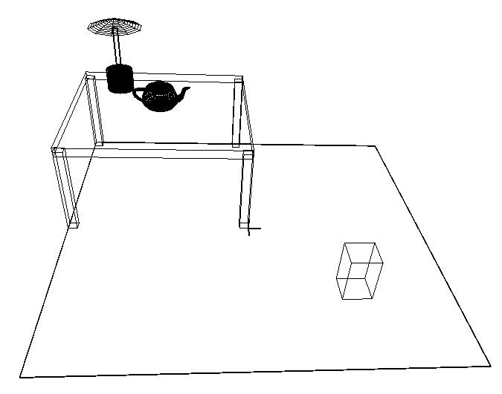
Using GLU/GLUT Objects
From geometric primitives: point, line, polygon
GLU/GLUT provides very simple object primitives
glutWireCube
glutWireCone
gluCylinder
glutWireTeapot
Notes:
10.7 GRAPHICAL OBJECTS Although we have introduced multiple graphics paradigms, our development has been heavily based on a pipeline implementation of the synthetic-camera model. We made this choice because we want to support interactive three-dimensional applications with currently available hardware and software. Consequently, we have emphasized immediate-mode graphics where primitives are rendered to the screen when the code defining them is executed in an application program. Once primitives are rendered, they leave no trace other than their images on the screen and the contents of the frame buffer. Any changes in attributes or positioning require that we re-execute code in the application program. In addition, our desire to present the basics of implementation has led us to develop graphics in a manner that was never far from the details of the implementation. For all its benefits, this approach has not let us exploit many high-level alternatives to developing graphical applications.
Now we move to a higher level of abstraction and introduce two major concepts.
First, we expand our notion of objects from geometric objects, such as polygons and vectors, to include most of the elements within a graphics program, such as viewers, lights, and material properties.
Second, we focus on objects that exist even after their images have been drawn and even if we never display them. We have already seen that we can create such objects using display lists as in Chapter 3.
Here we investigate other approaches, such as the use of classes in C++ or structures in C. Although the OpenGL API does not support this approach directly, we do not have to abandon OpenGL. We still use OpenGL for rendering, and we regard what we develop as a software layer on top of OpenGL.

Slide 11
glutWireCube(size)
Each glu/glut Object has its default size, position, and orientation
You need to perform Modeling transformation to make it right for you
glutWireCube(1.0) - ‘wire’ means wire frame
Put a 1x1x1 Cube with its center at World (0,0,0)
To create a 2 x 0.1 x 2 table top - need to call
glScalef(2, 0.1, 2) before you call glutWireCube(1.0)
???????

Slide 12
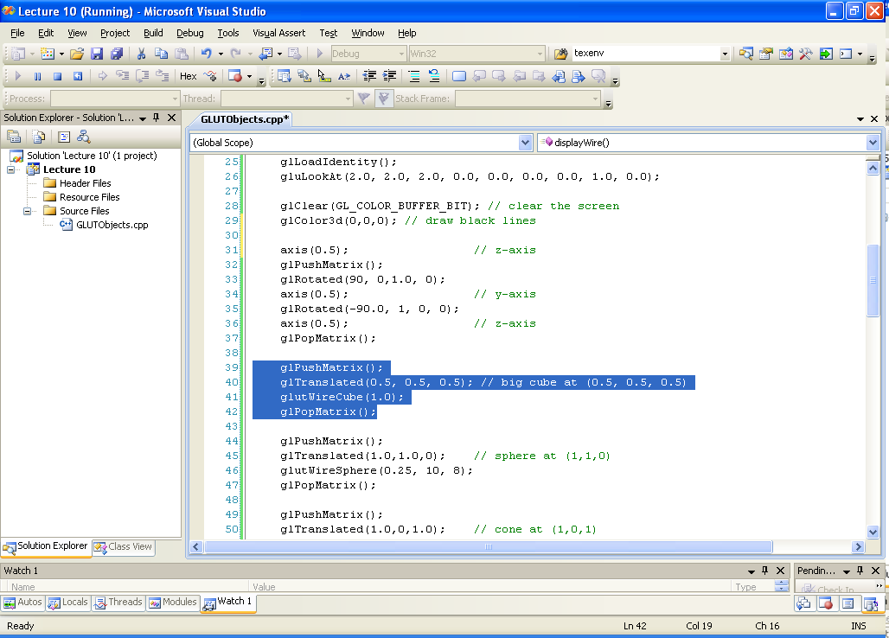
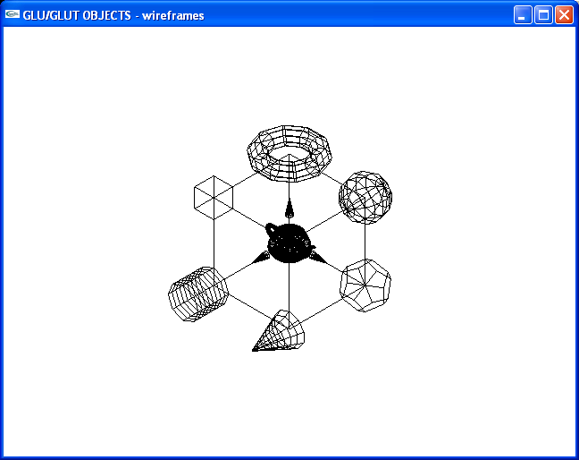
glutWireCube(size)
Each glu/glut object has its default size, position, and orientation
You need to perform modeling transformation to make it right for you
glutWireCube(1.0) - ‘wire’ means wire frame
Put a 1x1x1 cube with its center at world (0,0,0)
To create a 2 x 0.1 x 2 table top - need to call glScalef(2, 0.1, 2) before you call glutWireCube(1.0)

Slide 13
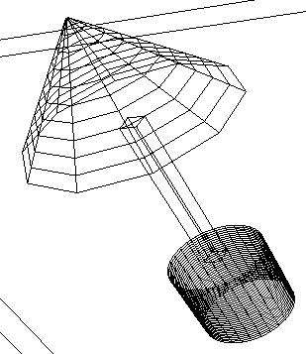
gluCylinder()
Sphere, Cylinder,
Disk, Partial Disk
Three steps to create a Cylinder
1. Create a GLU quadric object
gluquadricObj *p = gluNewQuadric();
2. Set to wire frame mode
gluQuadricDrawStyle(GLU__LINE);
3. Derive a Cylinder object from p
gluCylinder(p, base, top, height, slice, stacks)
z
Base
radius
top
radius
y
height
Base
num. of vertical lines
num. of horizontal lines
x
The default position is also with base at z = 0 plane

Slide 14
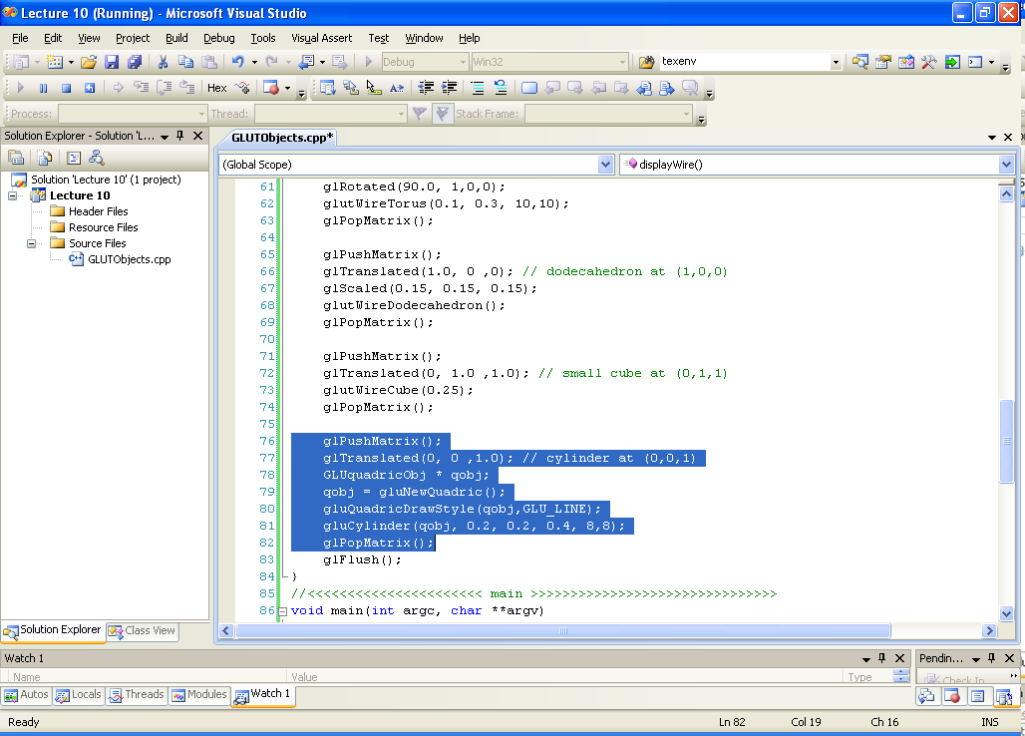
gluCylinder()
sphere, cylinder,
disk, partial disk
Three steps to create a cylinder
1. Create a GLU quadric object
GLUquadricObj *p = gluNewQuadric();
2. Set to wire frame mode
gluQuadricDrawStyle(GLU__LINE);
3. Derive a cylinder object from p
gluCylinder(p, base, top, height, slice, stacks)
z
base
radius
top
radius
y
height
Base
num. of vertical lines
num. of horizontal lines
x
The default position is also with base at z = 0 plane

Slide 15
glutWireCone()
Use glutWireCone and gluCylinder to make a lamp
glutWireCone(Base, height, slices, stacks)
A polygon approximation of a Cone.
Default position: its base at Z = 0 plane
Base: the width of its base
height: the height of the cone
slices: the number of vertical lines used
to make up the cone
stace: the number of horizontal lines used
to make up the cone
z
y
x
Base

Slide 16
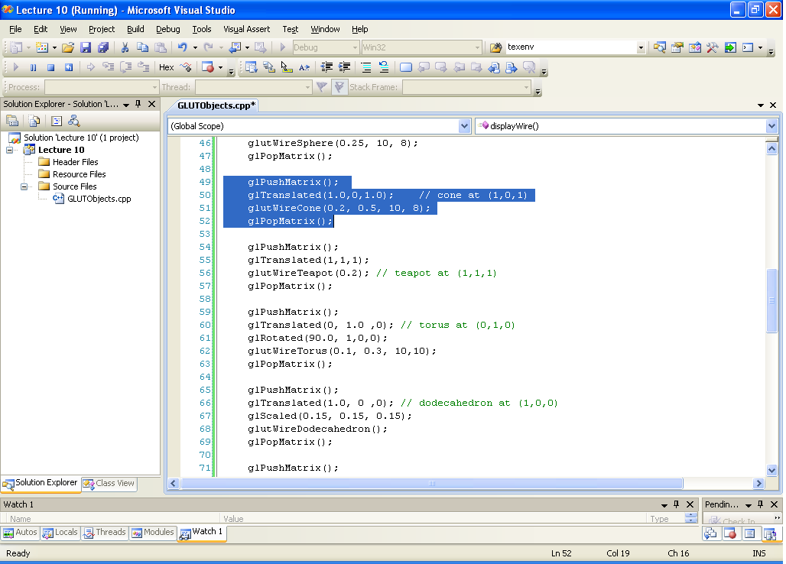
glutWireCone()
Use glutWireCone and gluCylinder to make a lamp
z
y
glutWireCone(base, height, slices, stacks)
A polygon approximation of a cone.
Default position: its base at Z = 0 plane
base: the width of its base
height: the height of the cone
slices: the number of vertical lines used
to make up the cone
stace: the number of horizontal lines used
to make up the cone
x
Base

Slide 17
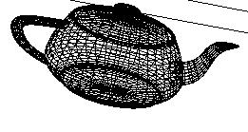
glutWireTeapot()
The famous Utah Teapot has become an unofficial computer graphics mascot
glutWireTeapot(0.5)
Create a teapot with size 0.5, and position its center at (0,0,0)
Again, you need to apply transformations to position it at the right spot

Slide 18
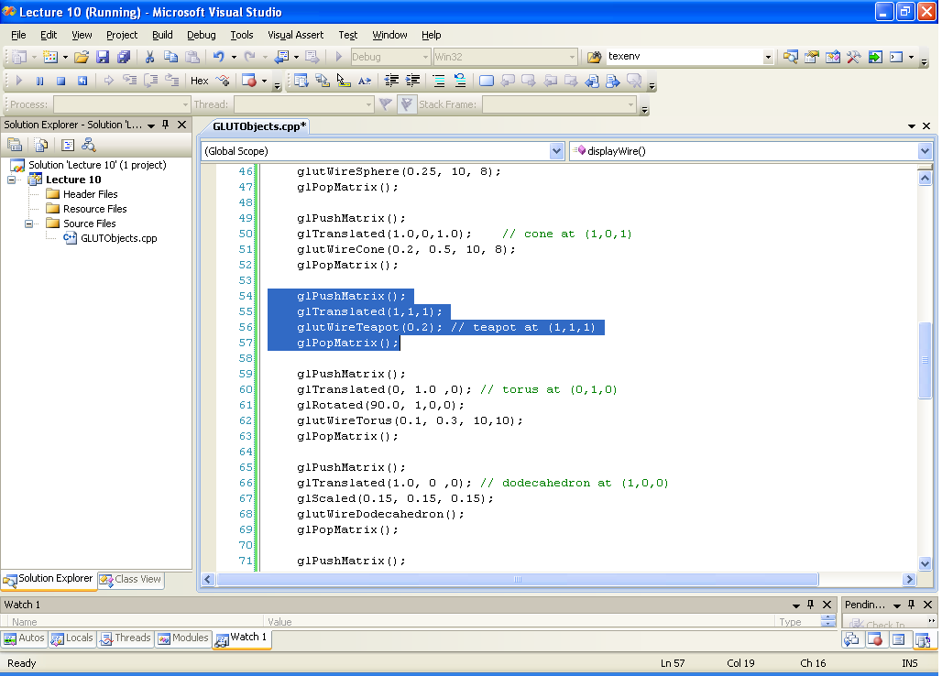
glutWireTeapot()
The famous Utah Teapot has become an unofficial computer graphics mascot
glutWireTeapot(0.5) -
Create a teapot with size 0.5, and position
its center at (0,0,0)
Again, you need to apply transformations to position it at the right spot

Slide 19
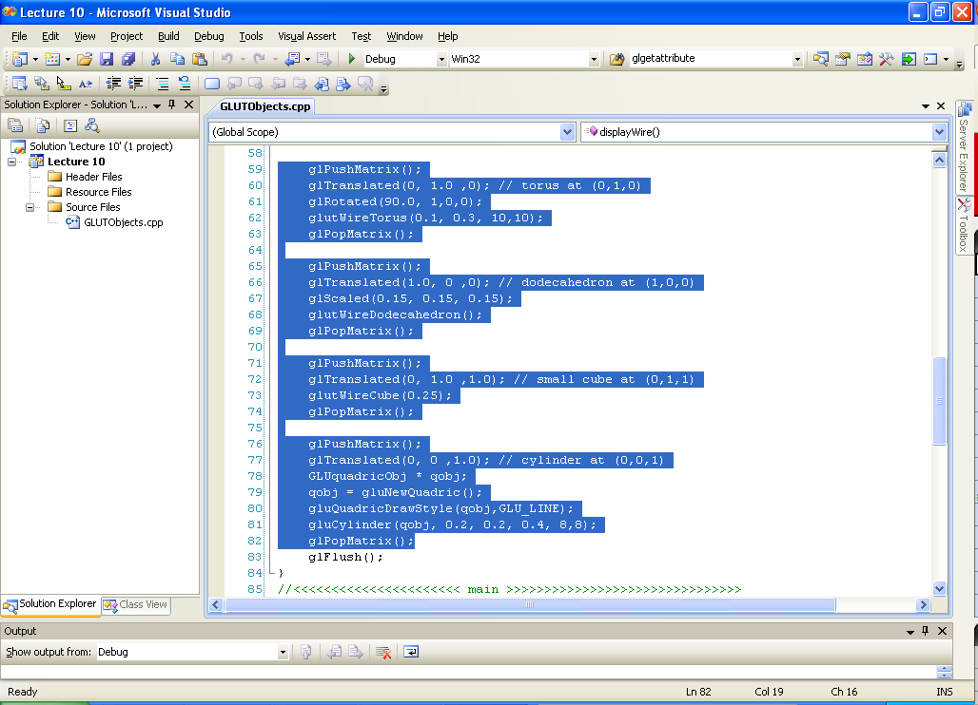

Slide 20
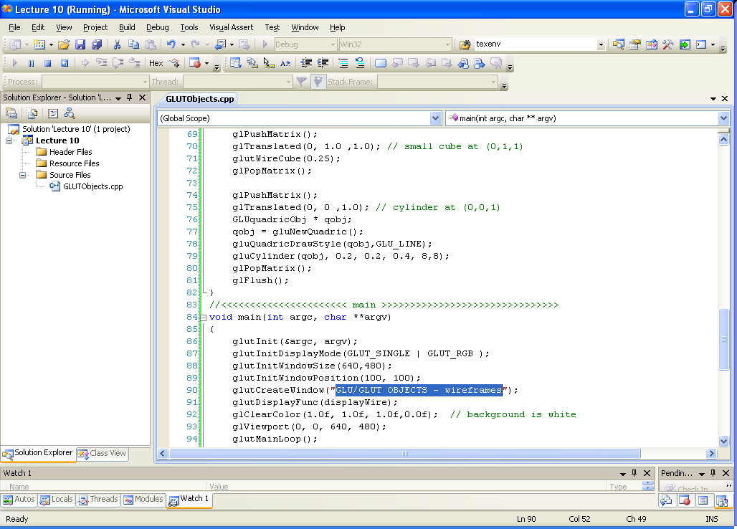

GLUTObjects.cpp
GLUTObjects.cpp
Class Participation 1

Slide 21
GLUTObjects.cpp

Slide 22
Objectives
GLU/GLUT objects
Examine the limitations of Linear Modeling
Symbols and Instances
Introduce hierarchical models
Articulated models
Robots
Introduce Tree and DAG models
22

Slide 23
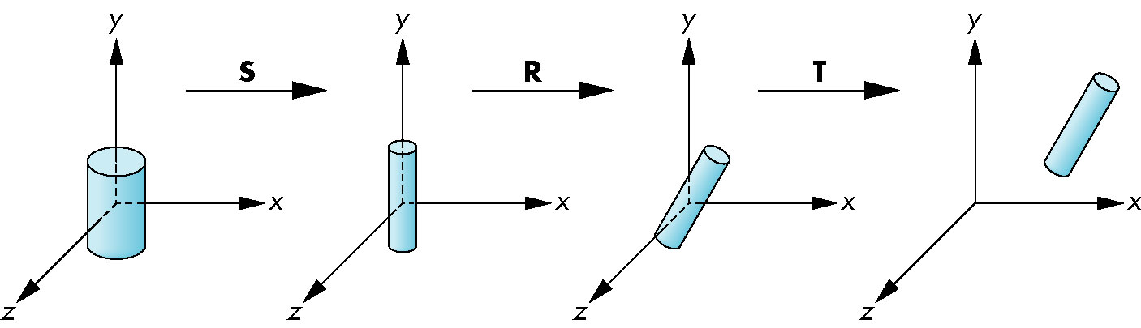
Instance Transformation (nonhierarchical model)
Start with a prototype Object (a symbol)
Each appearance of the Object in the Model is an instance
Must scale, orient, position
Defines instance transformation
23
Notes:
10.1 SYMBOLS AND INSTANCES Our first concern is how we can store a model that may include many sophisticated objects. There are two immediate issues: how we define an object more complex than the ones we have dealt with until now and how we represent a collection of these objects. Most APIs take a minimalist attitude toward primitives: They contain only a few primitives, leaving it to the user to construct more complex objects from these primitives. Sometimes additional libraries, such as GLU and GLUT, which we have used with OpenGL, provide objects built on top of the basic primitives. We assume that we have available a collection of basic three-dimensional objects provided by these options.
We can take a nonhierarchical approach to modeling by regarding these objects as symbols and by modeling our world as a collection of symbols. Symbols can include geometric objects, fonts, and application-specific sets of graphical objects. Symbols are usually represented at a convenient size and orientation. For example, a cylinder is usually oriented parallel to one of the axes, as shown in Figure 10.1, often with a unit height, a unit radius, and its bottom centered at the origin.

Slide 24
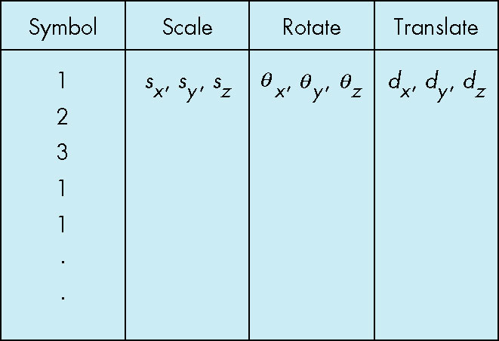
Symbol-instance Table
Can store a Model by assigning a number to each symbol and storing the parameters for the instance transformation
24
Notes:
We can also think of such a model in the form of a table, as shown in Figure 10.3.
Here each symbol is assumed to have a unique numerical identifier.
The table stores this identifier and the parameters necessary to build the instance transformation matrix.
The table shows that this modeling technique contains no information about relationships among objects.
However, the table contains all the information that we require to draw the objects and is thus a simple data structure or model for a group of geometric objects.
We could search the table for an object, change the instance transformation for an object, and add or delete objects.

Slide 25
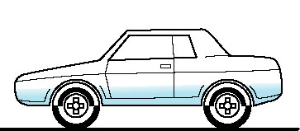
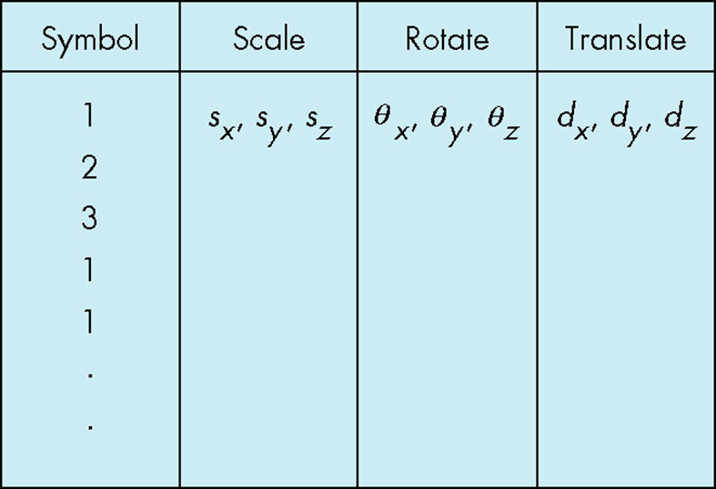
Relationships in Car Model (nonhierarchical model)
Symbol-instance Table does not show relationships between parts of Model
Consider Model of car
Chassis + 4 identical wheels
Two symbols
25
Notes:
10.2 HIERARCHICAL MODELS
Suppose that we wish to build a model of an automobile that we can animate.
We can compose the model from five parts—the chassis and the four wheels (Figure 10.4)— each of which we can describe by using our standard graphics primitives.

Slide 26
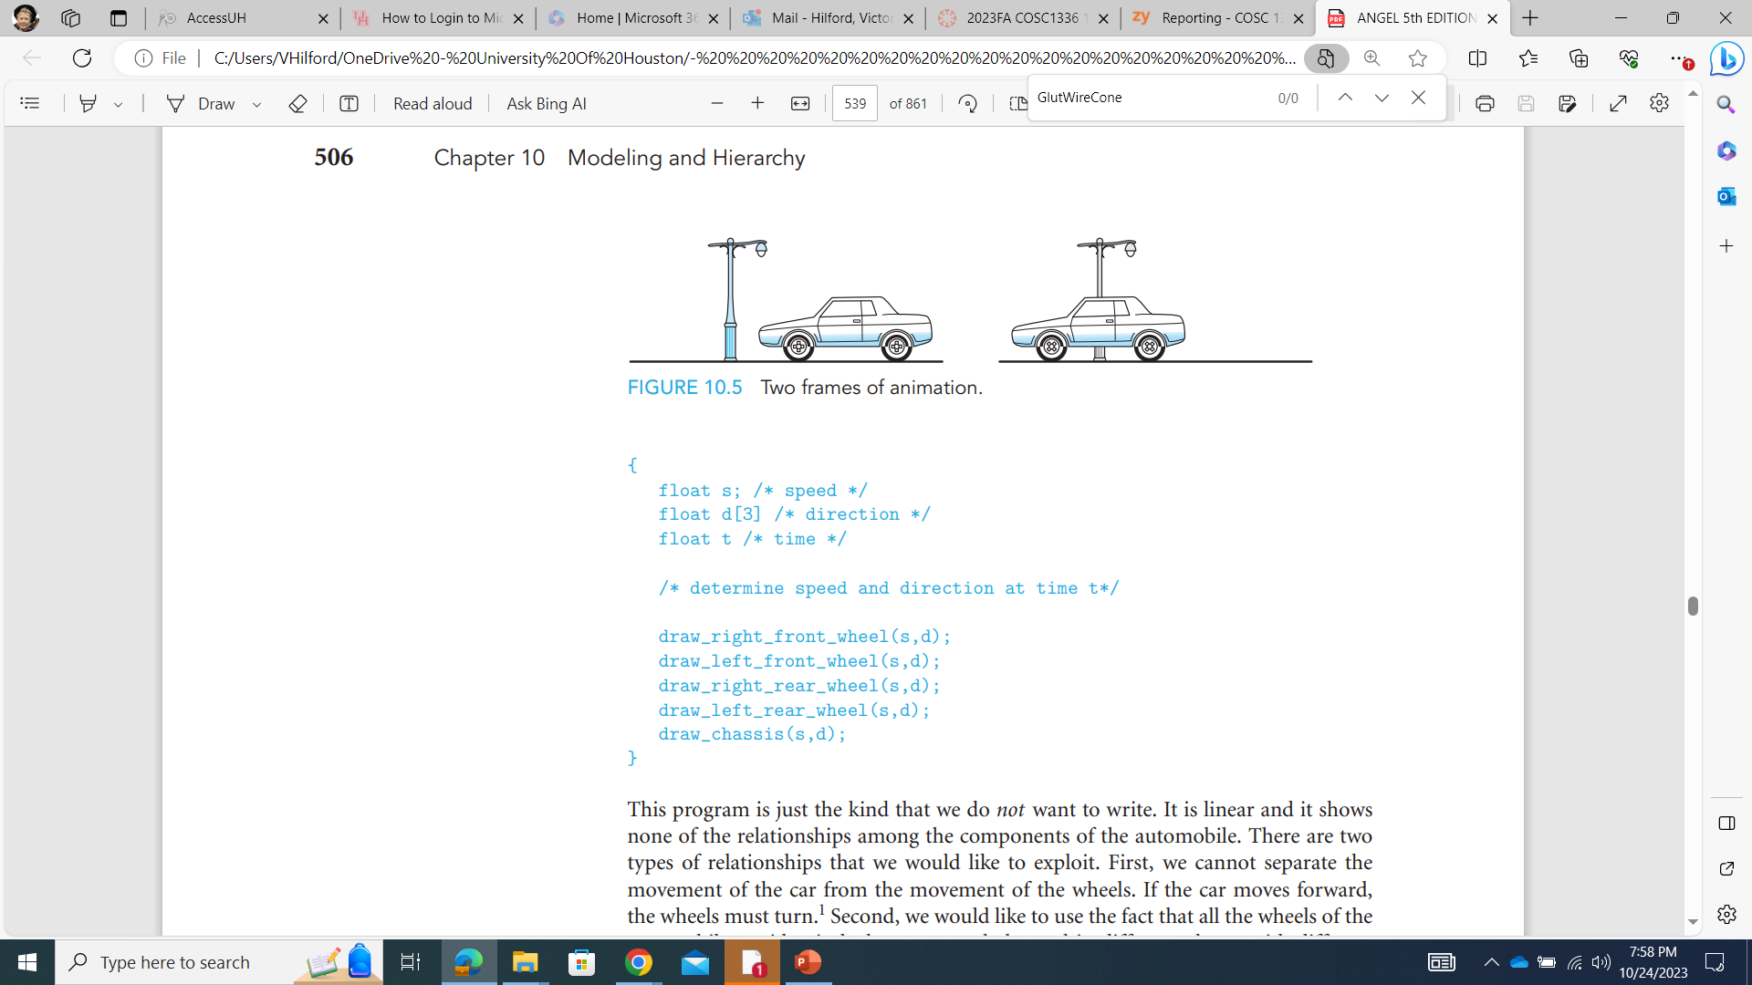
Structure Through Function Calls (speed & direction)
car(speed)
{
chassis()
wheel(right_front);
wheel(left_front);
wheel(right_rear);
wheel(left_rear);
}
Fails to show relationships well
Look at problem using a graph
26
Notes:
We could write a program to generate this animation by noting that if each wheel has a radius r, then a 360-degree rotation of a wheel must correspond to the car moving forward (or backward) a distance of 2πr.
The program could then contain one function to generate each wheel and another to generate the chassis.
All these functions could use the same input, such as the desired speed and direction of the automobile.

Slide 27
Objectives
GLU/GLUT objects
Examine the limitations of linear modeling
Symbols and instances
Introduce hierarchical models
Articulated models
Robots
Introduce Tree and DAG Models
27

Slide 28
Graphs (to represent relationships)
Set of nodes and edges (links)
Edge connects a pair of nodes
Directed or undirected
Cycle: directed path that is a loop
loop
28
Notes:
We can represent the relationships among parts of the models, both abstractly and visually, with graphs.
Mathematically, a graph consists of a set of nodes (or vertices) and a set of edges. Edges connect pairs of nodes or possibly connect a node to itself.
Edges can have a direction associated with them; the graphs we use here are all directed graphs, which are graphs that have their edges leaving one node and entering another.

Slide 29
Tree
Graph in which each node (except the root) has exactly one parent node
May have multiple children
Leaf or terminal node: no children
root node
leaf node
29

Slide 30
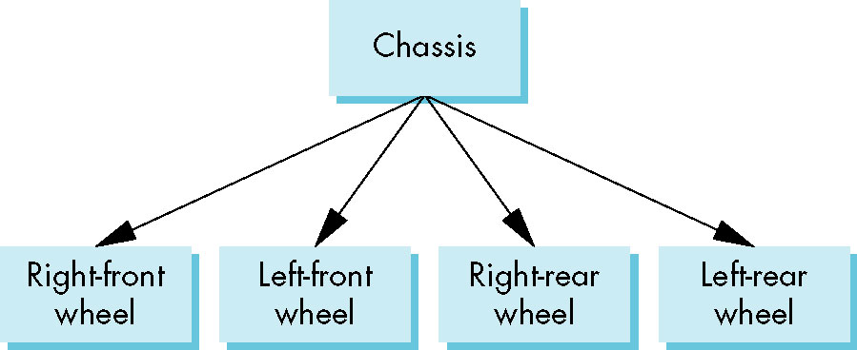
Tree Model of Car (hierarchical model)
30
Notes:
The most important type of graph we use is a tree.
A (connected) tree is a directed graph without closed paths or loops.
In addition, each node but one— the root node—has one edge entering it. Thus, every node except the root has a parent node, the node from which an edge enters, and can have one or more child nodes, nodes to which edges are connected.
A node without children is called a terminal node, or leaf.
Figure 10.6 shows a tree that represents the relationships in our car model. The chassis is the root node, and all four wheels are its children.
Although the mathematical graph is a collection of set elements, in practice, both the edges and nodes can contain additional information. For our car example, each node can contain information defining the geometric objects associated with it. The information about the location and orientation of the wheels can be stored either in their nodes or in the edges connecting them with their parent.

Slide 31
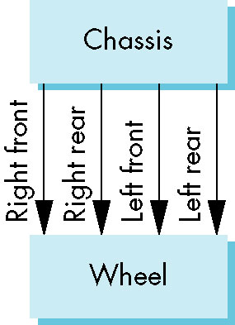
DAG Model of Car
If we use the fact that all the wheels are identical, we get a Directed Acyclic Graph
Not much different than dealing with a tree
31
Notes:
In most cars the four wheels are identical, so storing the same information on how to draw each one at four nodes is inefficient. We can use the ideas behind the instance transformation to allow us to use a single prototype wheel in our model. If we do so, we can replace the tree structure by the directed acyclic graph (DAG) in Figure 10.7.
In a DAG, although there are loops, we cannot follow directed edges around the loop. Thus, if we follow any path of directed edges from a node, the path terminates at another node, and in practice, working with DAGs is no more difficult than working with trees.
For our car, we can store the information that positions each instance of the single prototype wheel in the chassis node, in the wheel node, or with the edges.

Slide 32
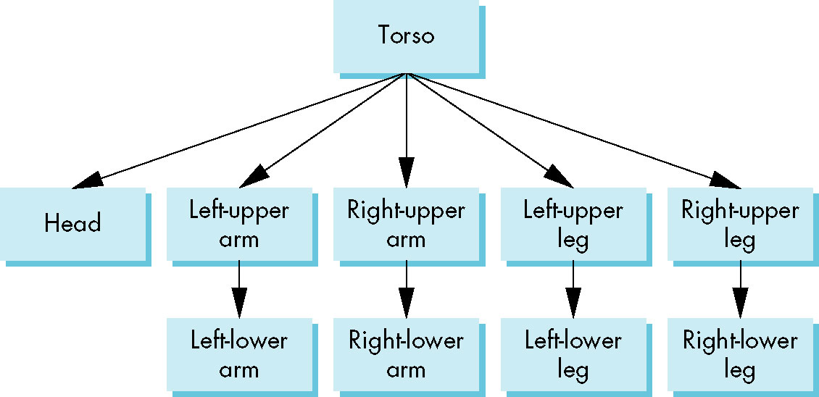
Modeling with Trees (hierarchical model)
Must decide what information to place in Nodes and what to put in Edges
Nodes
What to draw
Pointers to Children
Edges
May have information on incremental changes to transformation matrices (can also be store in nodes)
32

Slide 33
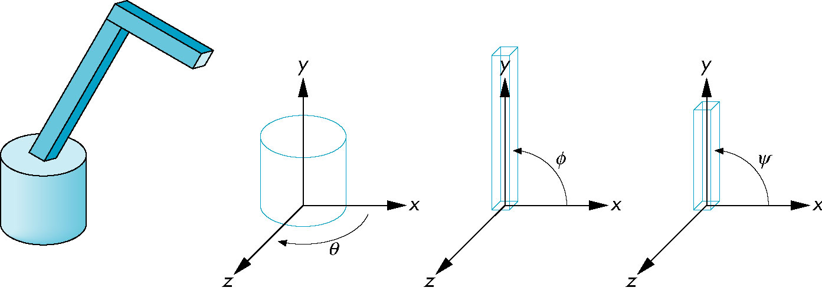
Robot Arm (hierarchical model)
Robot Arm
parts in their own
coordinate systems
33
Notes:
10.3 A ROBOT ARM Robotics provides many opportunities for developing hierarchical models.
Consider the simple robot arm illustrated in Figure 10.8(a). We can model it with three simple objects, or symbols, perhaps using only two parallelepipeds and a cylinder.
Each of the symbols can be built up from our basic primitives. The robot arm consists of the three parts shown in Figure 10.8(b).
The mechanism has three degrees of freedom, two of which can be described by joint angles between components and the third by the angle the base makes with respect to a fixed point on the ground.
In our model, each joint angle determines how to position a component with respect to the component to which it is attached, or in the case of the base, the joint angle positions it relative to the surrounding environment.

Slide 34
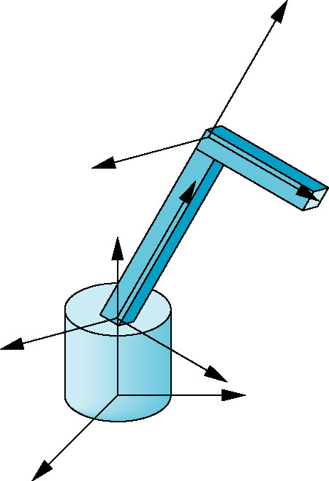
Articulated Models
Robot Arm is an example of an Articulated Model
Parts connected at joints
Can specify state of Model by giving all joint angles
ψ
φ
robot.c
Θ
34
Notes:
Each joint angle is measured in each component’s own frame.
We can rotate the base about its vertical axis by an angle θ. This angle is measured from the x-axis to some fixed point on the bottom of the base.
The lower arm of the robot is attached to the base by a joint that allows the arm to rotate in the plane z = 0 in the arm’s frame. This rotation is specified by an angle φ that is measured from the x-axis to the arm.
The upper arm is attached to the lower arm by a similar joint, and it can rotate by an angle ψ, measured like that for the lower arm, in its own frame. As the angles vary, we can think of the frames of the upper and lower arms as moving relative to the base.
By controlling the three angles, we can position the tip of the upper arm in three dimensions.

Slide 35
Relationships in Robot Arm
Θ
Base rotates independently
Single angle determines position
Lower Arm attached to Base
Its position depends on rotation of Base
Must also translate relative to Base and rotate about connecting joint
Upper Arm attached to Lower Arm
Its position depends on both Base and Lower Arm
Must translate relative to Lower Arm and rotate about joint connecting to Lower Arm
φ
ψ
35
Notes:
Suppose that we wish to write a program to render our simple robot model.
Rather than defining each part of the robot and its motion independently, we take an incremental approach.
The base of the robot can rotate about the y-axis in its frame by the angle θ. Thus, we can describe the motion of any point p on the base by applying a rotation matrix Ry(θ ) to it.
The lower arm is rotated about the z-axis in its own frame, but this frame must be shifted to the top of the base by a translation matrix T(0, h1, 0), where h1 is the height above the base to the point where the joint between the base and the lower arm is located. However, if the base has rotated, then we must also rotate the lower arm, using Ry(θ ). We can accomplish the positioning of the lower arm by applying Ry(θ )T(0, h1, 0)Rz(φ) to the arm’s vertices.
We can interpret the matrix Ry(θ )T(0, h1, 0) as the matrix that positions the lower arm relative to the object or world frame and Rz(φ) as the matrix that positions the lower arm relative to the base.
Equivalently, we can interpret these matrices as positioning the frames of the lower arm and base relative to some world frame, as shown in Figure 10.9.
When we apply similar reasoning to the upper arm, we find that this arm has to be translated by a matrix T(0, h2, 0) relative to the lower arm and then rotated by Rz(ψ). The matrix that controls the upper arm is thus Ry(θ )T(0, h1, 0)Rz(φ)T(0, h2, 0)Rz(ψ). The form of the display function for an OpenGL program to display the robot as a function of the joint angles shows how we can alter the model-view matrix incrementally to display the various parts of the model efficiently:

Slide 36
Required Matrices
Θ
Rotation of Base: R_{b}
Apply M = R_{b} to Base
Translate Lower Arm relative to Base: T_{lu}
Rotate Lower Arm around joint: R_{lu}
Apply M = R_{b} T_{lu} R_{lu} to lower arm
Translate Upper Arm relative to Lower Arm: T_{uu}
Rotate Upper Arm around joint: R_{uu}
Apply M = R_{b} T_{lu} R_{lu} T_{uu} R_{uu} to Upper Arm
φ
ψ
36

Slide 37
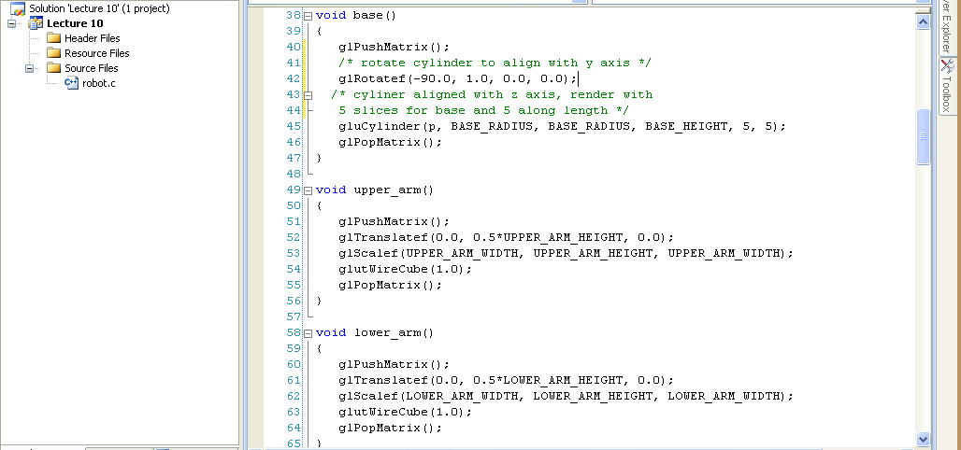
Robot
Base
Upper Arm
Lower Arm

Slide 38
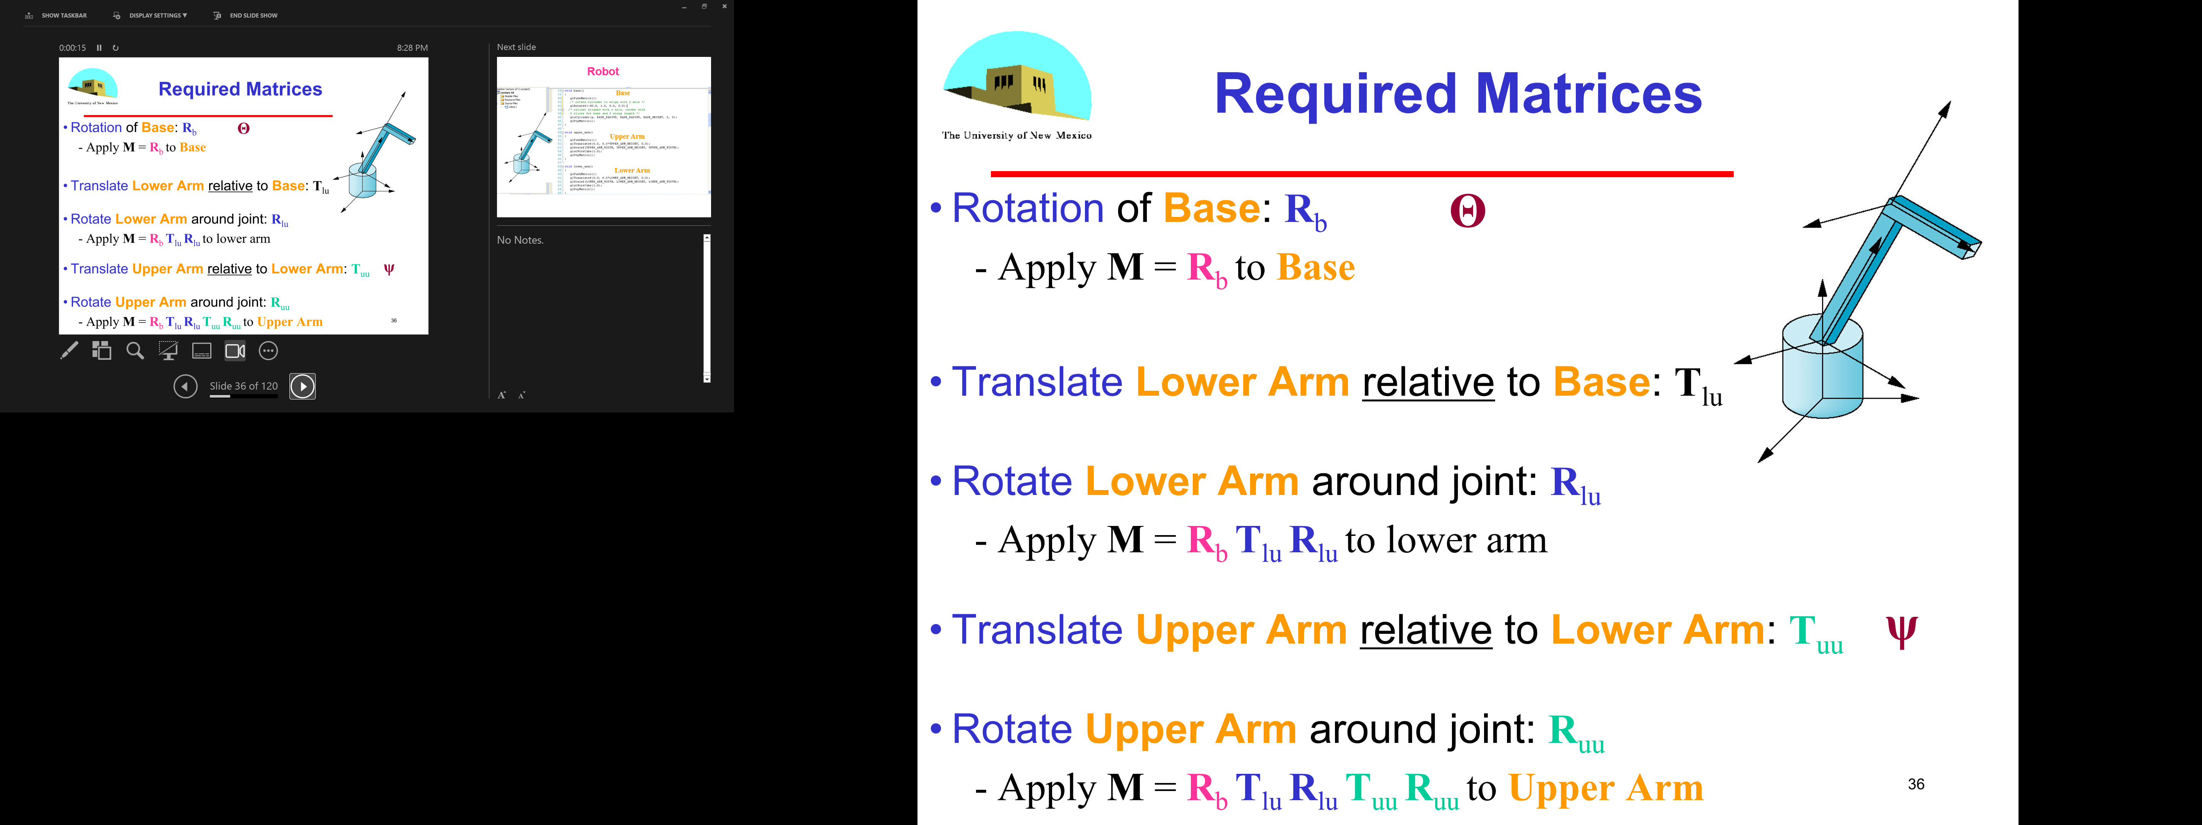
OpenGL Code for Robot Arm
robot_arm()
{
glRotate(theta, 0.0, 1.0, 0.0);
base();
glTranslate(0.0, h1, 0.0);
glRotate(phi, 0.0, 1.0, 0.0);
lower_arm();
glTranslate(0.0, h2, 0.0);
glRotate(psi, 0.0, 1.0, 0.0);
upper_arm();
}
Θ
φ
ψ
38

Slide 39
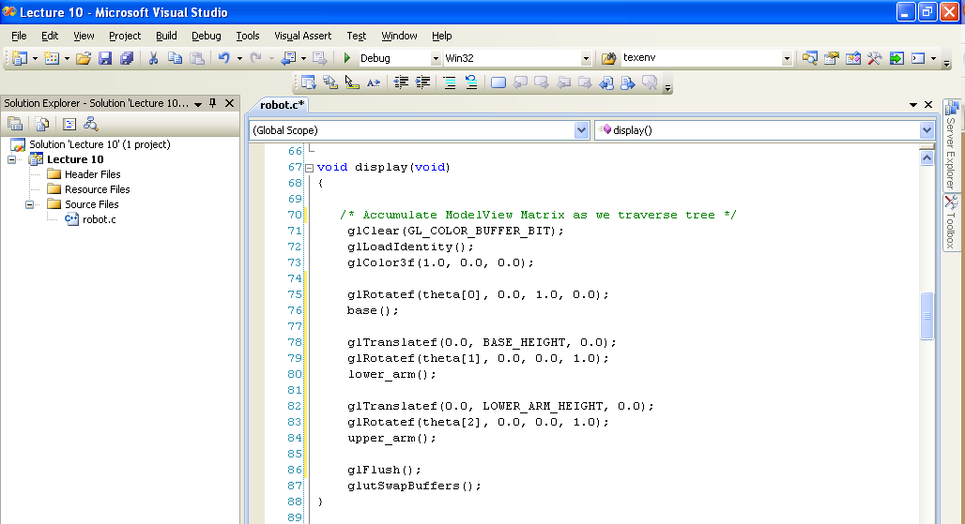
Robot

Slide 40
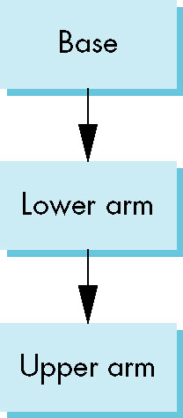
Tree Model of Robot
Note code shows relationships between Parts of Model
Can change “look” of Parts easily without altering relationships
Simple example of Tree Model
Want general node structure for nodes
40
Notes:
Note that we have described the positioning of the arm independently of the details of the individual parts. As long as the positions of the joints do not change, we can alter the form of the robot by changing only the functions that draw the three parts. This separation makes it possible to write separate functions to describe the components and to animate the robot.
Figure 10.10 shows the relationships among the parts of the robot arm as a tree.

Slide 41
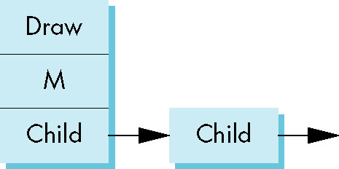
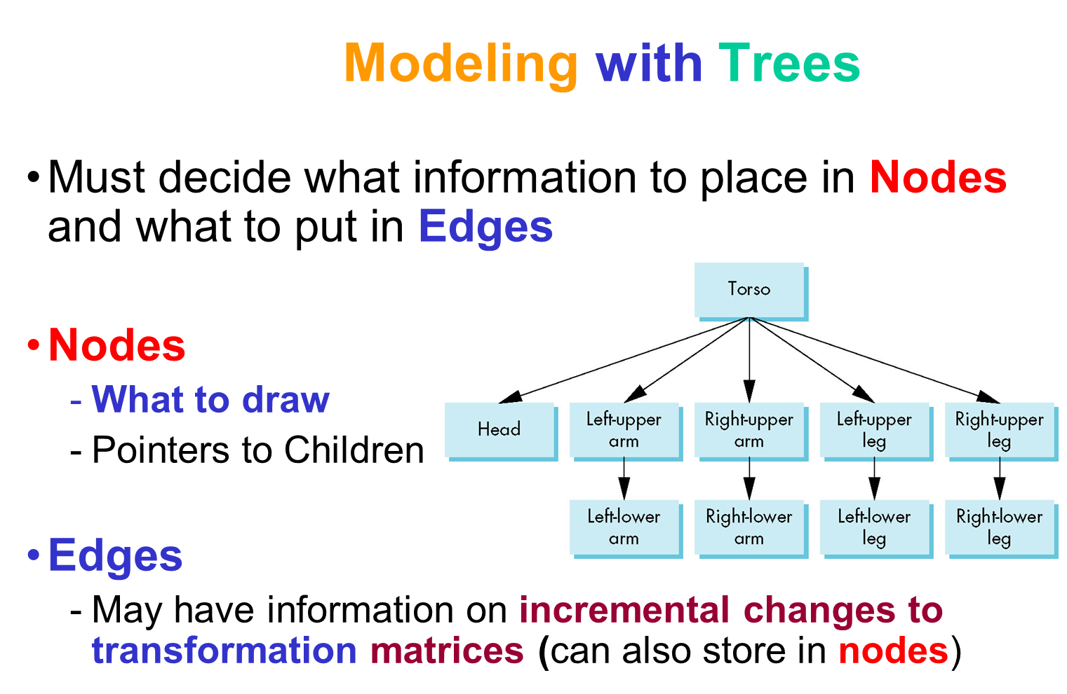
Possible Node Structure
Code for drawing Part or
pointer to drawing function
Linked List of pointers to Children
Matrix relating Node to Parent
41
Notes:
Returning to the tree in Figure 10.10, we can look at it as a tree data structure of nodes and edges—as a graph.
If we store all the necessary information in the nodes, rather than in the edges, then each node (Figure 10.11) must store at least three items:
1. A pointer to a function that draws the object represented by the node
2. A homogeneous-coordinate matrix that positions, scales, and orients this node (and its children) relative to the node’s parent
3. Pointers to children of the node
Drawing an object described by such a tree requires performing a tree traversal. That is, we must visit every node; at each node, we must compute the matrix that applies to the primitives pointed to by the node and must display these primitives.

Slide 42
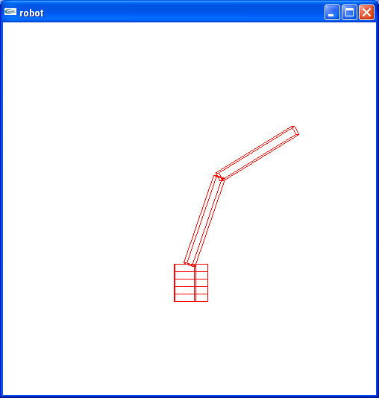
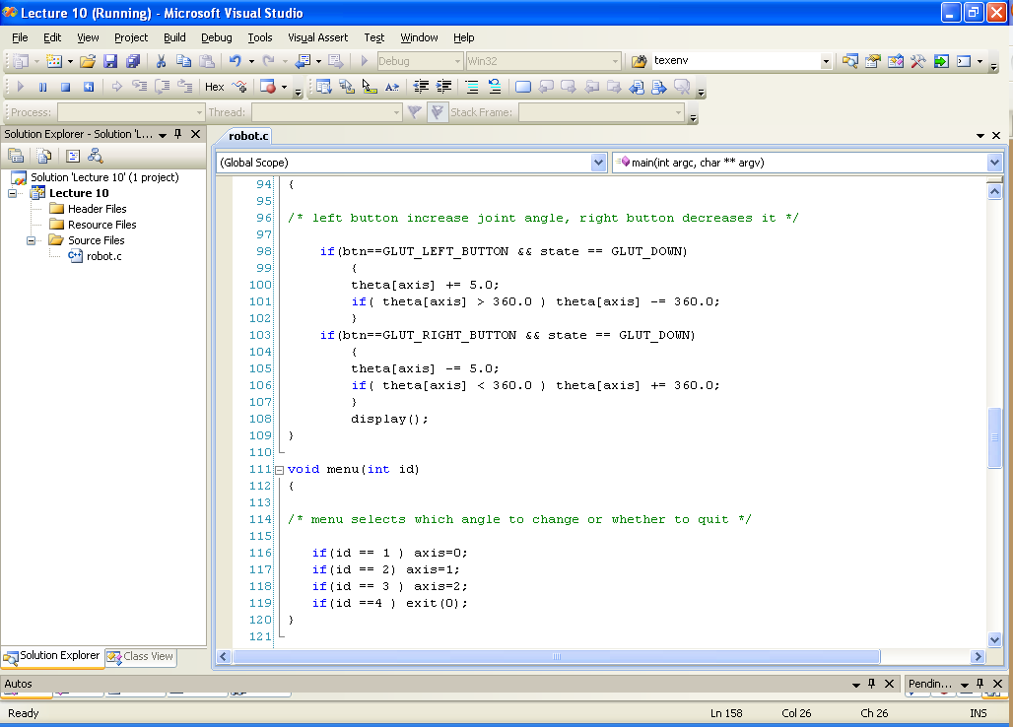
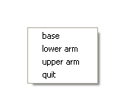
Robot Arm
Midle Button
CAN YOU control the Robot to get to THIS position????
robot.c
Class Participation 2
42

Slide 43
Robot Arm
Midle Button
43

Slide 44
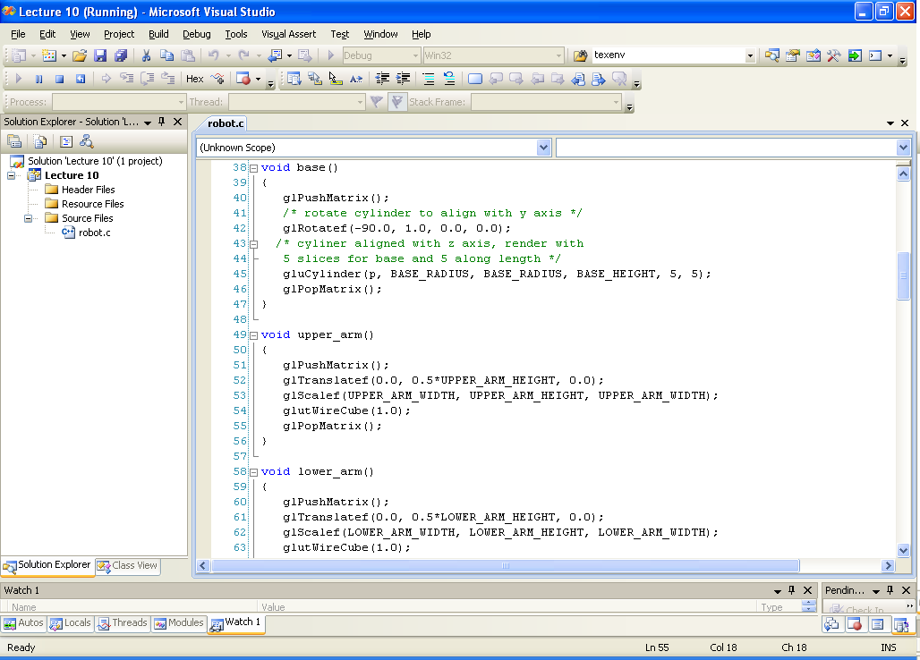
Robot Arm
What is the robot made of ????
robot.c
Class Participation 1
44

Slide 45
Robot Arm
What is the robot made of ????
45

Slide 46
Generalizations
Need to deal with multiple Children
How do we represent a more General Tree?
How do we traverse such a Data Structure?
Animation
How to use dynamically?
Can we create and delete Tree Nodes during execution?
46

Slide 47
Transformations
Two ways to specify transformations
(1) Each Part of the Object is transformed independently relative to the origin
Not the OpenGL Way!
y
Translate the Base by (5,0,0);
Translate the Lower Arm by (5,0,0);
Translate the Upper Arm by (5,0,0);
…
x
z

Slide 48
Relative Transformation
A better (and easier) way:
(2) Relative transformation: Specify the transformation for each Object relative to its Parent

Slide 49
Object Dependency
A graphical scene often consists of many small Objects
The attributes of an Object (positions, orientations) can depend on Others
A Robot Hammer!
Hammer
Upper Arm
Lower Arm
Base

Slide 50
Hierarchical Representation - Scene Graph
We can describe the Object dependency using a Tree Structure
Root node
Base
The position and orientation of
an Object can be affected
by its parent, grand-parent,
grand-grand-parent … nodes
Lower Arm
Upper Arm
This Hierarchical Representation
is referred to as Scene Graph
Leaf node
Hammer

Slide 51
Relative Transformation
Relative Transformation: Specify the Transformation for each Object relative to its parent
Step 1: Translate Base and
its descendants by (5,0,0);

Slide 52
Relative Transformation (2)
Step 2: Rotate the Lower Arm and all its descendants
Relative to its local y axis by -90 degree
y
y
z
x
x
z

Slide 53
Relative Transformation
Represent Relative Transformations using Scene Graph
Base
Translate (5,0,0)
Lower Arm
Rotate (-90) about its local y
Upper Arm
Apply all the way
down
Hammer
Apply all the way
down

Slide 54
Do it in OpenGL
Translate base and all its descendants by (5,0,0)
Rotate the lower arm and its descendants by -90 degree about the locally
glMatrixMode(GL_MODELVIEW);
glLoadIdentity();
… // setup your camera
glTranslatef(5,0,0);
Draw_base();
glRotatef(-90, 0, 1, 0);
Draw_lower _arm();
Draw_upper_arm();
Draw_hammer();
Base
Lower Arm
Upper Arm
Hammer

Slide 55
A more complicated Example
How about this Model?
Scene Graph?
Left Hammer
Right Hammer
base
Lower Arm
Lower Arm
Upper Arm
Upper Arm
Hammer
Hammer
Base
(Left Hammer)
(Right Hammer)

Slide 56
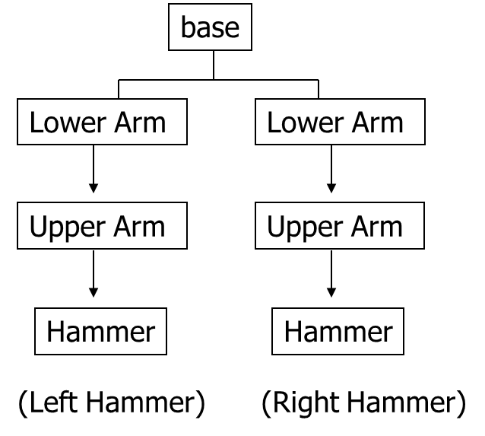
Do this …
Base and everything – translate (5,0,0)
Left Hammer – rotate 75 degree about the local y
Right Hammer – rotate -75 degree about the local y

Slide 57
Depth-First Traversal
Base and everything – translate (5,0,0)
Left Hammer – rotate 75 degree about the local y
Right Hammer – rotate -75 degree about the local y
Program this transformation by Depth-First Traversal
Do transformation(s)
Draw Base
Do transformation(s)
Draw Left Arm
Do transformation(s)
Draw Right Arm
Base
Lower arm
Lower Arm
What are they?
Upper Arm
Upper Arm
Hammer
Hammer
(Left Hammer)
(Right Hammer)
Depth First Traversal

Slide 58
How about this?
Base and everything – Translate (5,0,0)
Left Hammer – Rotate 75 degree about the local y
Right Hammer – Rotate -75 degree about the local y
Base
Draw Base
Draw Left Hammer
Draw Right Hammer
Translate(5,0,0)
Lower Arm
Lower Arm
Upper Arm
Upper Arm
Rotate(75, 0, 1, 0)
What’s wrong?!
Hammer
Hammer
Rotate(-75, 0, 1, 0)
(Left Hammer)
(Right Hammer)

Slide 59
Something is wrong …
What’s wrong? – We want to transform the Right Hammer relative to the Base, not to the Left Hammer
How about this?
Do
Draw Base
Do
Draw Left Hammer
Do
Draw Right Hammer
We should undo the
Left Hammer transformation
before we transform the Right
Hammer
Translate(5,0,0)
Rotate(75, 0, 1, 0)
Need to undo this first
What’s wrong?!
Rotate(-75, 0, 1, 0)

Slide 60
Undo the previous transformation(s)
Need to save the ModelView Matrix right after we draw Base
Initial ModelView M
Draw Base
Draw Left Hammer
Draw Right Hammer
Translate(5,0,0) -> M = M x T
Undo the previous transformation
means we want to restore the
Modelview Matrix M to what
it was here
Rotate(75, 0, 1, 0)
i.e., save M right here
…
And then restore the saved
Modelview Matrix
Rotate(-75, 0, 1, 0)

Slide 61
OpenGL Matrix Stack
We can use OpenGL Matrix Stack to perform matrix save and restore
Initial ModelView M
Do
Draw Base
Do
Draw Left Hammer
Do
Draw Right Hammer
Translate(5,0,0) -> M = M x T
* Store the current Modelview Matrix
Make a copy of the current matrix
and push into OpenGL Matrix Stack:
call glPushMatrix()
continue to modify the current matrix
* Restore the saved Matrix
- pop the top of the Matrix and
copy it back to the current
Modelview Matrix: Call glPopMatrix()
Rotate(75, 0, 1, 0)
Rotate(-75, 0, 1, 0)

Slide 62
push and pop Matrix Stack
A simple OpenGL routine:
push
glTranslate(5,0,0)
Draw_Base();
glPushMatrix();
glRotate(75, 0,1,0);
Draw_Left_Hammer();
glPopMatrix();
glRotate(-75, 0,1,0);
Draw_Right_Hammer();
Base
pop
Lower Arm
Lower Arm
Upper Arm
Upper Arm
Hammer
Hammer
(Left Hammer)
(Right Hammer)
Depth First Traversal

Slide 63
Push and Pop Matrix Stack
Nested Push and Pop operations
Modelview Matrix(M) Stack
M = I
M = M1
M = M1 x M2 M1xM2
M = M1 x M2 x M3 M1xM2xM3
M1 x M2
M = M1 x M2 x M3 x M4
M = M1 x M2 x M3
M1 x M2
M = M1 x M2 x M3 x M5
M = M1 x M2
glMatrixMode(GL_MODELVIEW);
glLoadIdentity();
… // Transform using M1;
… // Transform using M2;
glPushMatrix();
… // Transform using M3
glPushMatrix();
.. // Transform using M4
glPopMatrix();
…// Transform using M5
…
glPopMatrix();

Slide 64
Hierarchical Modeling II
64

Slide 65
Objectives
Build a Tree-structured Model of a humanoid figure
Examine various Traversal strategies
Build a generalized Tree-Model structure that is independent of the particular Model
65
Notes:
10.4 TREES AND TRAVERSAL Figure 10.12 shows a boxlike representation of a humanoid that might be used for a robot model or in a virtual reality application. If we take the torso as the root element, we can represent this figure with the tree shown in Figure 10.13. Once we

Slide 66
Objectives
Build a Tree-structured Model of a humanoid figure
Examine various traversal strategies
Build a generalized tree-model structure that is independent of the particular model
66

Slide 67
Hierarchical Model of Robot used in Simulations

Slide 68
Hierarchical Model of Figure used in games

Slide 69
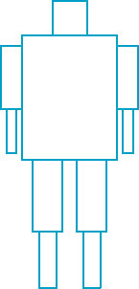
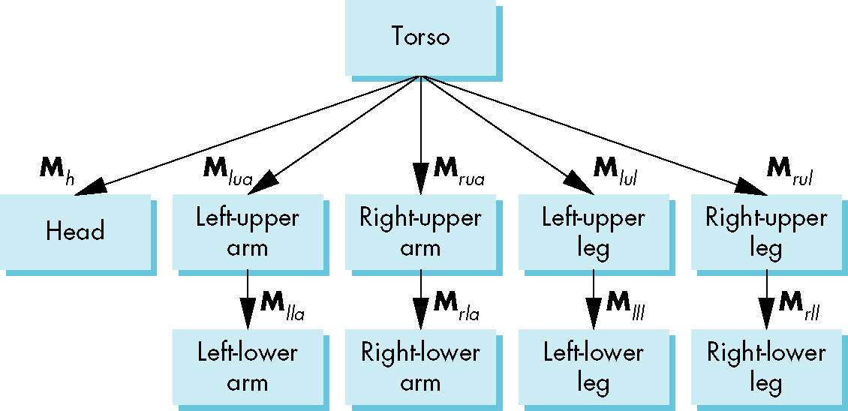
Humanoid Figure
dynamic.c
69
Notes:
10.4 TREES AND TRAVERSAL Figure 10.12 shows a boxlike representation of a humanoid that might be used for a robot model or in a virtual reality application.
If we take the torso as the root element, we can represent this figure with the tree shown in Figure 10.13.
Once we have positioned the torso, the position and orientation of the other parts of the model are determined by the set of joint angles.

Slide 70
Building the Model
Can build a simple implementation using quadrics: ellipsoids and cylinders
Access Parts through functions
torso()
left_upper_arm()
Matrices describe position of node with respect to its parent
M_{lla} positions left lower arm with respect to left upper arm
70
Notes:
Let’s assume that we have functions, such as head and left_upper_arm, that draw the individual parts (symbols) in their own frames.
We can now build a set of nodes for our tree by defining matrices that position each part relative to its parent, exactly as we did for the robot arm.
If we assume that each body part has been defined at the desired size, each of these matrices is the concatenation of a translation matrix with a rotation matrix. We can show these matrices, as we do in Figure 10.14, by using the matrices to label the edges of the tree.
Remember that each matrix represents the incremental change when we go from the parent to the child.

Slide 71
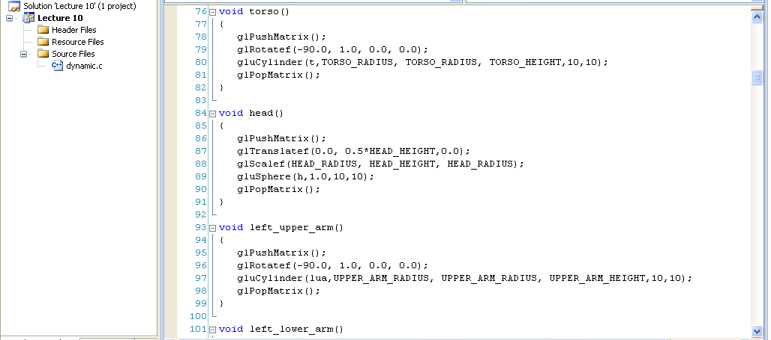
Building the Model with Cylinder
Can build a simple implementation using quadrics: ellipsoids and cylinders
Access parts through functions
torso()
left_upper_arm()
Matrices describe position of node with respect to its parent
M_{lla} positions left lower leg with respect to left upper arm
71

Slide 72
Tree with Matrices (pre-order traversal)
72
Notes:
The interesting part of this example is how we do the traversal of the tree to draw the figure. In principle, we could use any tree-traversal algorithm, such as a depth-first or breadth-first search. Although, in many applications, it is insignificant which traversal algorithm is used, we will see that there are good reasons for always using the same algorithm for traversing our graphs. We will always traverse our trees left to right, depth first. That is, we start with the left branch, follow it to the left as deep as we can go, then go back up to the first right branch, and proceed recursively. This order of traversal is called a pre-order traversal.

Slide 73
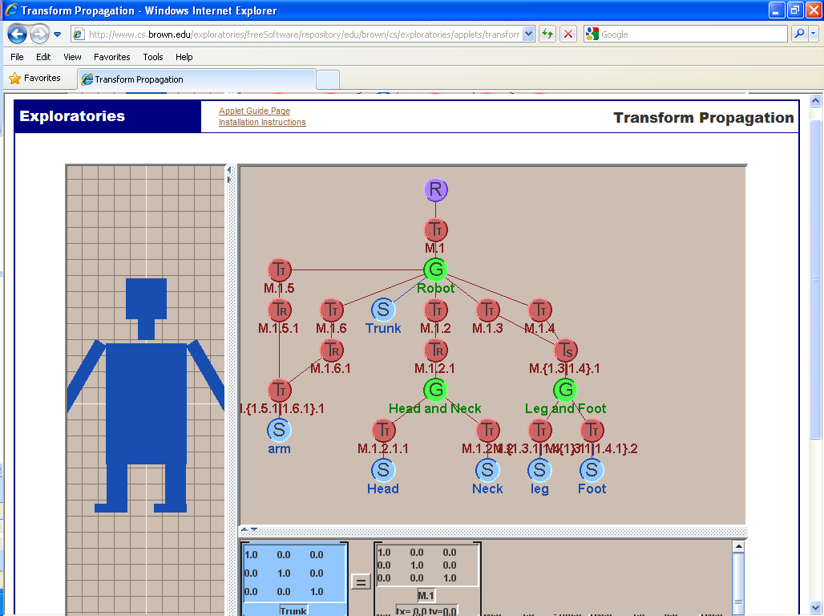
Applet with Matrices
http://www.cs.brown.edu/exploratories/freeSoftware/repository/edu/brown/cs/exploratories/applets/transformPropagation/transform_propagation_java_browser.html

Slide 74
Objectives
Build a tree-structured model of a humanoid figure
Examine various Traversal strategies
Build a generalized tree-model structure that is independent of the particular model
74
Notes:
We can write a tree-traversal function in one of two ways.
We can do the traversal explicitly in the application code, using stacks to store the required matrices and attributes as we move through the tree.
We can also do the traversal recursively. In this second approach, the code is simpler because the storage of matrices and attributes is done implicitly.
We develop both approaches because both are useful and because their development yields further insights into how we can build graphics systems.

Slide 75
Display and Traversal
The position of the Figure is determined by 11 joint angles (two for the head and one for each other part)
Display of the Tree requires a graph Traversal
Visit each node once
Display function at each node that describes the part associated with the node, applying the correct transformation matrix for position and orientation
75

Slide 76
Transformation Matrices
There are 10 relevant Matrices
M positions and orients entire Figure through the torso which is the Root node
M_{h} positions head with respect to torso
M_{lua}, M_{rua}, M_{lul}, M_{rul} position arms and legs with respect to torso
M_{lla}, M_{rla}, M_{lll}, M_{rll} position lower parts of limbs with respect to corresponding upper limbs
76
Notes:
We can now build a set of nodes for our tree by defining matrices that position each part relative to its parent, exactly as we did for the robot arm. If we assume that each body part has been defined at the desired size, each of these matrices is the concatenation of a translation matrix with a rotation matrix.

Slide 77
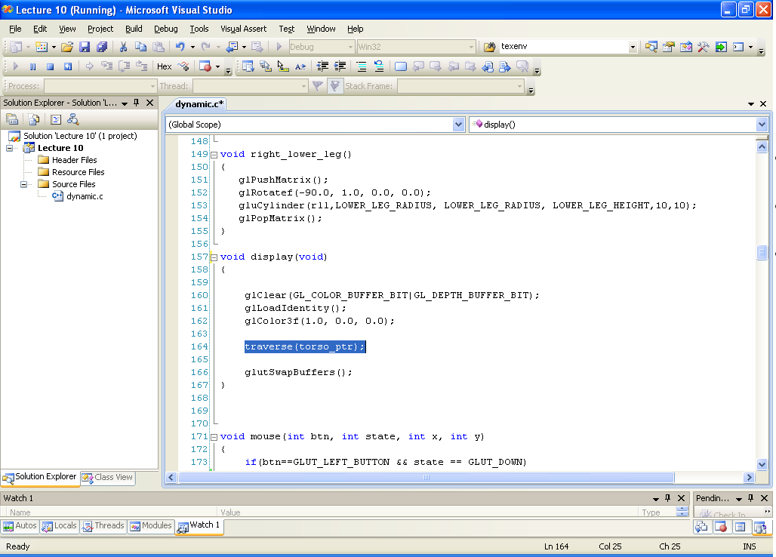
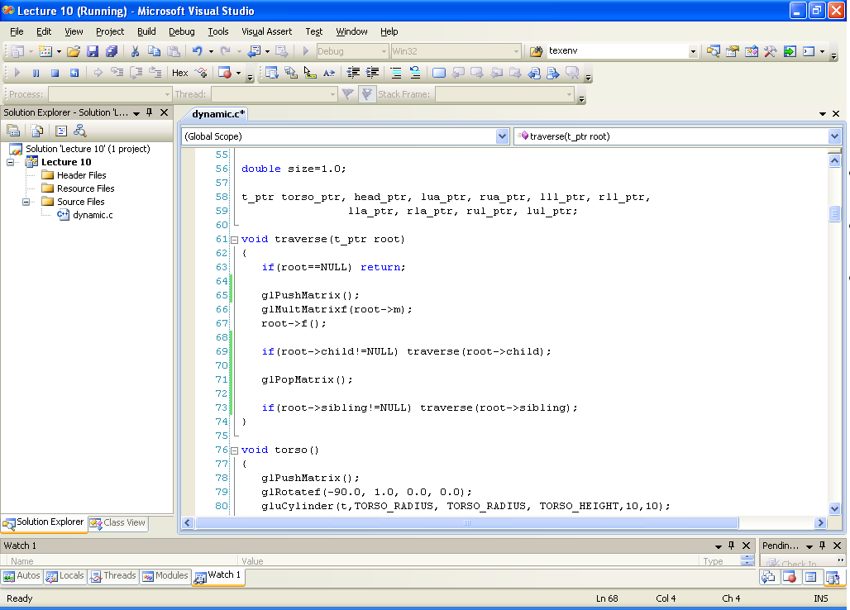
Transformation Matrices
Display and Traversal
There are 10 relevant matrices
M positions and orients entire figure through the torso which is the root node
M_{h} positions head with respect to torso
M_{lua}, M_{rua}, M_{lul}, M_{rul} position arms and legs with respect to torso
M_{lla}, M_{rla}, M_{lll}, M_{rll} position lower parts of limbs with respect to corresponding upper limbs
Traversal ??????
root L R – preOrder
77

Slide 78
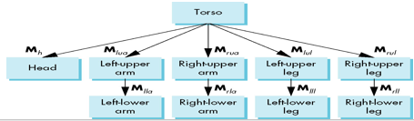
1. Stack-based Traversal (explicitly traversal)
Set model-view matrix to M and draw torso
Set model-view matrix to MM_{h} and draw head
For left-upper arm need MM_{lua} and so on
Rather than recomputing MM_{lua} from scratch or using an inverse matrix, we can use the Matrix stack to store M and other matrices as we traverse the Tree
78
Notes:
We can write a tree-traversal function in one of two ways.
We can do the traversal explicitly in the application code, using stacks to store the required matrices and attributes as we move through the tree.
We can also do the traversal recursively. In this second approach, the code is simpler because the storage of matrices and attributes is done implicitly.

Slide 79
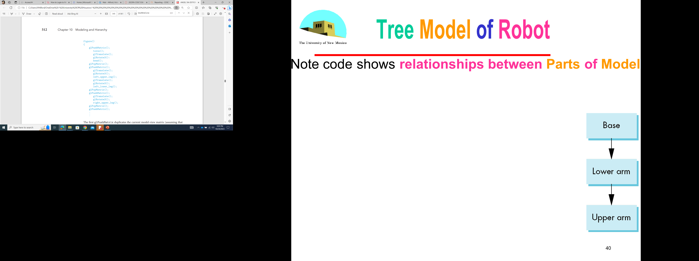
Traversal Code
save present model-view matrix
update model-view matrix for head
recover original model-view matrix
save it again
update model-view matrix
for left upper arm
recover and save original
model-view matrix again
rest of code
79
figure() {
glPushMatrix()
torso();
glRotate3f(…);
head();
glPopMatrix();
glPushMatrix();
glTranslate3f(…);
glRotate3f(…);
left_upper_arm();
glPopMatrix();
glPushMatrix();
Notes:
Hence, our traversal code will have translations and rotations intermixed with pushes and pops of the model-view matrix.

Slide 80
Tree with Matrices
glPushMatrix()
….
glPopMatrix();
glPushMatrix()
glPopMatrix();
glPushMatrix()
80
Notes:
10.4.1 A Stack-Based Traversal Consider the drawing of the figure by a function figure. This function might be called from the display callback or from a mouse callback in an animation that uses the mouse to control the joint angles.
The model-view matrix, M, in effect when this function is invoked, determines the position of the figure relative to the rest of the scene (and to the camera).
The first node that we encounter results in the torso being drawn with M applied to all the torso’s primitives.
We then trace the leftmost branch of the tree to the node for the head.
There we invoke the function head with the model-view matrix updated to MMh.
Next, we back up to the torso node, then go down the subtree defining the left leg. This part looks just like the code for the robot arm; we draw the left-upper leg with the matrix MMlul and the left-lower leg with matrix MMlulMlll.
Then we move on to the right leg, left arm, and left leg.
Each time we switch limbs, we must back up to the root and recover M. It is probably easiest to think in terms of the current transformation matrix of Chapter 4—the model-view matrix C that is applied to the primitives defined at a node.2 The matrix C starts out as M, is updated to MMh for the head, and later to MMlulMlll, and so on. The user program must manipulate C before each call to a function defining a part of the figure.
Note that as we back up the tree to start the right upper arm, we need M again. Rather than reforming it (or any other matrix we might need to reuse in a more complex model) we can store it on a stack with glPushMatrix and recover it with glPopMatrix.
Hence, our traversal code will have translations and rotations intermixed with pushes and pops of the model-view matrix.

Slide 81
Analysis
The code describes a particular Tree and a particular traversal strategy
Can we develop a more general approach?
Note that the sample code does not include state changes, such as changes to colors
May also want to use glPushAttrib and glPopAttrib to protect against unexpected state changes affecting later parts of the code
81
Notes:
We have not considered how attributes such as color and material properties are handled by our traversal of a hierarchical model.
Attributes are state variables: Once set, they remain in place until changed again. Hence, we must be careful as we traverse our tree.
For example, suppose that within the code for torso, we set the current color to red; then within the code for head, we set the color to blue. If there are no other color changes, the color will still be blue as we traverse the rest of the tree and may remain blue after we leave the code for figure.
OpenGL has the functions glPushAttrib and glPopAttrib which allow us to deal with attributes in a manner similar to our use of the model-view matrix. If we push the attributes on the attribute stack on entrance to the function figure, and pop on exit, we have restored the attributes to their original state.
In a more complex model, we can apply these ideas recursively. If, for example, we want to use a more detailed model of the head—one incorporating eyes, ears, a nose, and a mouth—then we could model these parts separately. The head would then itself be modeled hierarchically, and its code would include the pushing and popping of matrices and attributes.

Slide 82
Objectives
Build a tree-structured model of a humanoid figure
Examine various traversal strategies
Build a Generalized Tree Model structure that is independent of the particular Model
82

Slide 83
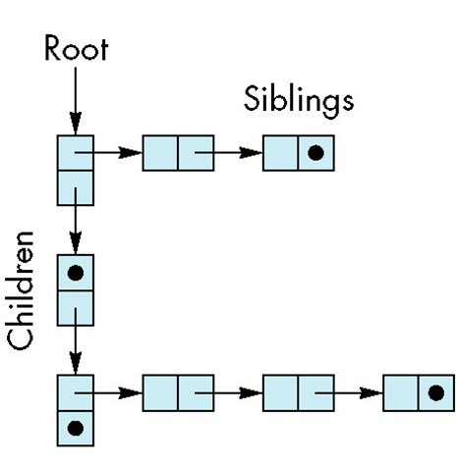
2. General Tree Data Structure (traversal)
Need a data structure to represent Tree and an algorithm to traverse the tree
We will use a left-child right sibling structure
Uses Linked Lists
Each node in data structure has two pointers
Left: next node
Right: Linked List of children
83
Notes:
Pushing and popping of matrices and attributes are slow operations. The alternative is to carefully manage the state within the application program.
10.5 USE OF TREE DATA STRUCTURES
Our second approach is to use a standard tree data structure to represent our hierarchy and then to render it with a traversal algorithm that is independent of the model.
We use a left-child, right-sibling structure.

Slide 84
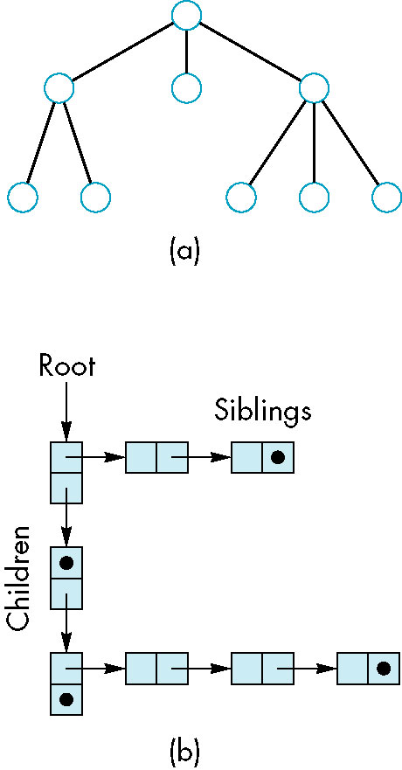
Left-Child Right-Sibling Tree
84
Notes:
Consider the alternate representation of a tree in Figure 10.15.
It is arranged such that all the elements at the same level are linked left to right.
The children of a given node are represented as a second list arranged from the leftmost child to the rightmost. This second list points downward in Figure 10.15.
This representation describes the structure of our hierarchical figure, but the structure still lacks the graphical information.

Slide 85
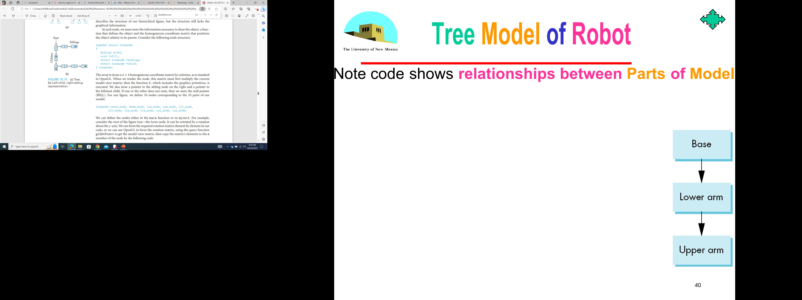
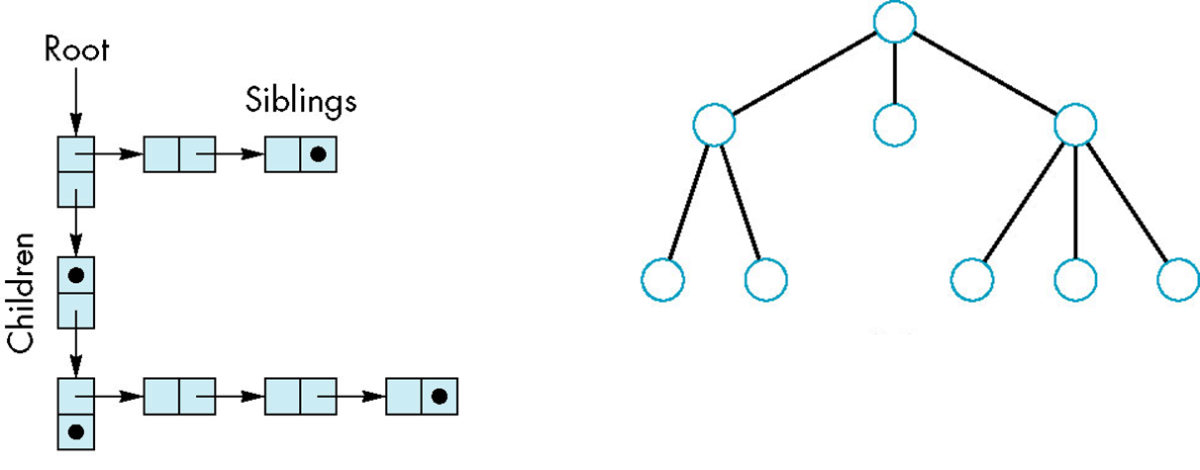
Tree node Structure
At each node we need to store
Pointer to a function f that draws the Object represented by the node
Homogeneous coordinate matrix m to multiply on the right of the current Model-View Matrix
Represents changes going from parent to node
In OpenGL this matrix is a 1D array storing matrix by columns
Pointer to sibling
Pointer to child
85
Notes:
At each node, we must store the information necessary to draw the object:
- a function that defines the object and
- the homogeneous coordinate matrix that positions the object relative to its parent.
Consider the following node structure:
typedef struct treenode {
GLfloat m[16];
void (*f)();
struct treenode *sibling;
struct treenode *child; }
treenode;
The array m stores a 4 × 4 homogeneous coordinate matrix by columns, as is standard in OpenGL. When we render the node, this matrix must first multiply the current model-view matrix; then the function f, which includes the graphics primitives, is executed. We also store a pointer to the sibling node on the right and a pointer to the leftmost child. If one or the other does not exist, then we store the null pointer (NULL). For our figure, we define 10 nodes corresponding to the 10 parts of our model

Slide 86
C Definition of treenode
typedef struct treenode
{
GLfloat m[16];
void (*f)(); // draw
struct treenode *sibling;
struct treenode *child;
} treenode;
86
Notes:
The array m stores a 4 × 4 homogeneous coordinate matrix by columns, as is standard in OpenGL.
When we render the node, this matrix must first multiply the current model-view matrix; then the function f, which includes the graphics primitives, is executed. We also store a pointer to the sibling node on the right and a pointer to the leftmost child. If one or the other does not exist, then we store the null pointer (NULL).

Slide 87
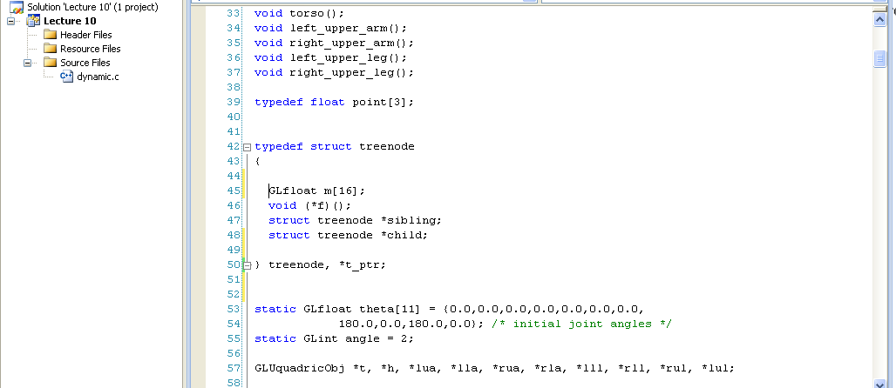
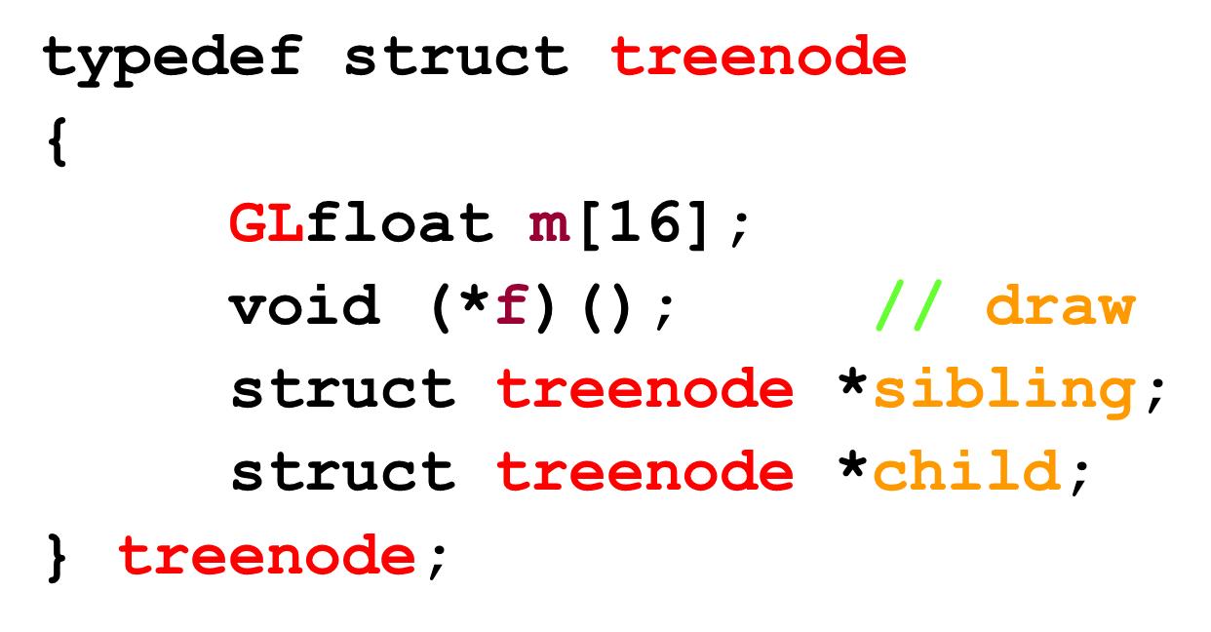
C Definition of treenode
typedef struct treenode
{
GLfloat m[16];
void (*f)();
struct treenode *sibling;
struct treenode *child;
} treenode;
87
Notes:
For our figure, we define 10 nodes corresponding to the 10 parts of our model: treenode torso_node, head_node, lua_node, rua_node, lll_node, rll_node, lla_node, rla_node, rul_node, lul_node;
We can define the nodes either in the main function or in myinit.

Slide 88
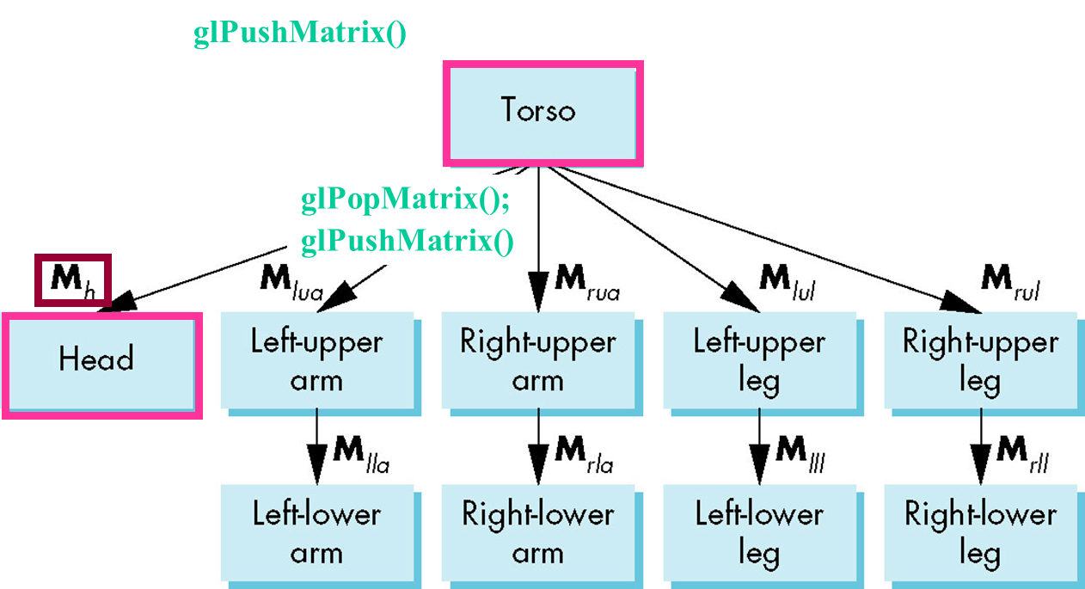
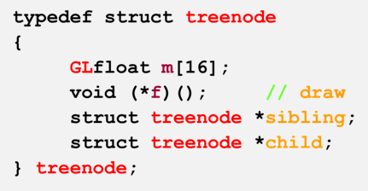
Defining the torso node
treenode torso_node, head_node, lua_node, … ;
/* use OpenGL functions to form matrix */
glLoadIdentity();
glRotatef(theta[0], 0.0, 1.0, 0.0);
/* move model-view matrix to m */
glGetFloatv(GL_MODELVIEW_MATRIX, torso_node.m)
torso_node.f = torso; /* torso() draws torso */
torso_node.sibling = NULL;
torso_node.child = &head_node;
88
Notes:
For example, consider the root of the figure tree—the torso node.
It can be oriented by a rotation about the y-axis. We can form the required rotation matrix element by element in our code, or we can use OpenGL to form the rotation matrix, using the query function glGetFoatv to get the model-view matrix, then copy the matrix’s elements to the m member of the node by the following code:
glLoadIdentity();
glRotatef(theta[0], 0.0, 1.0, 0.0);
glGetFloatv(GL_MODELVIEW_MATRIX,torso_node.m);
The function to be executed is the torso function that draws a cylinder.
The torso node has no siblings, and its leftmost child is the head node, so the rest of torso node is given as follows: torso_node.f = torso; torso_node.sibling = NULL; torso_node.child = &head_node

Slide 89
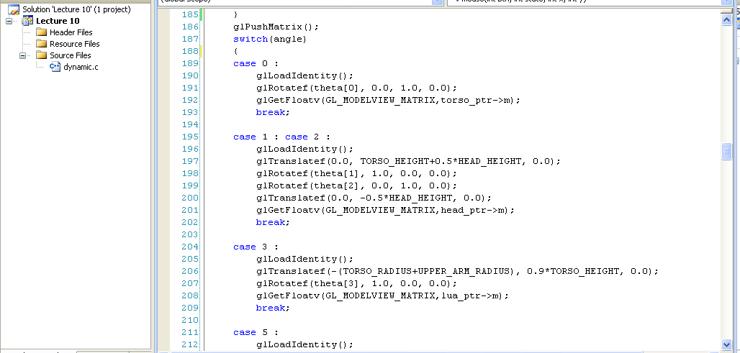
Defining the torso node
treenode torso_node, head_node, lua_node, … ;
/* use OpenGL functions to form matrix */
glLoadIdentity();
glRotatef(theta[0], 0.0, 1.0, 0.0);
/* move model-view matrix to m */
glGetFloatv(GL_MODELVIEW_MATRIX, torso_node.m)
torso_node.f = torso; /* torso() draws torso */
torso_node.sibling = NULL;
torso_node.child = &head_node;
89

Slide 90
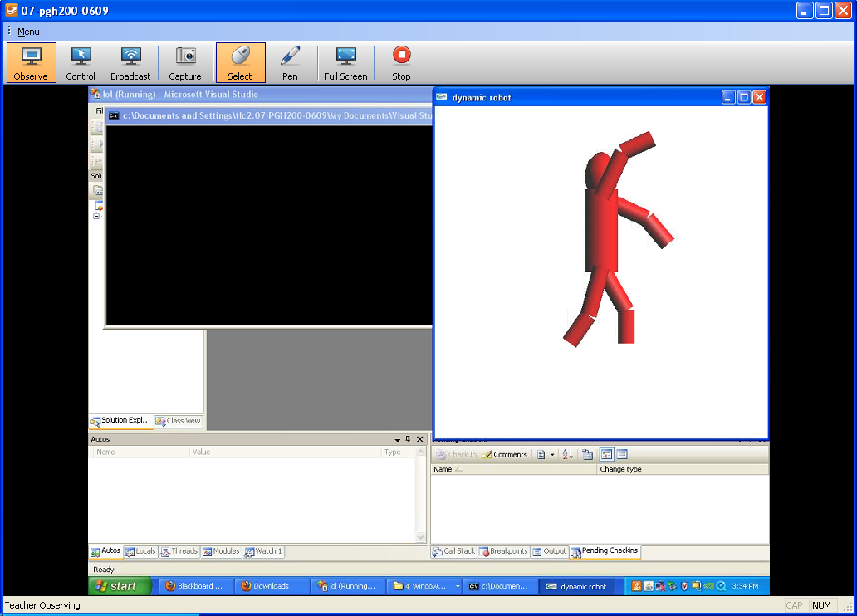

CAN YOU control the dynamic robot to get to THIS position????
dynamic.c
Class Participation 3
90
Notes:
One of the nice aspects of this traversal method is that it is completely independent of the particular tree; thus, we can use a generic display callback such as the following:
void display(void) {
glClear(GL_COLOR_BUFFER_BIT|GL_DEPTH_BUFFER_BIT);
glLoadIdentity();
traverse(&torso_node);
glutSwapBuffers(); }

Slide 91
91
Notes:
One of the nice aspects of this traversal method is that it is completely independent of the particular tree; thus, we can use a generic display callback such as the following:
void display(void) {
glClear(GL_COLOR_BUFFER_BIT|GL_DEPTH_BUFFER_BIT);
glLoadIdentity();
traverse(&torso_node);
glutSwapBuffers(); }

Slide 92
Notes
The position of Figure is determined by 11 joint angles stored in theta[11]
Animate by changing the angles and redisplaying
We form the required Matrices using glRotate and glTranslate
More efficient than software
Because the matrix is formed in model-view Matrix, we may want to first push original model-view Matrix on Matrix stack
92
Notes:
In this code, we again animate the figure by controlling individual joint angles, which are selected from a menu and are incremented and decremented through the mouse buttons.
Thus, the dynamics of the program are in the mouse callback, which changes an angle, recomputes the appropriate node matrix, and then posts a redisplay:

Slide 93



Preorder Traversal root Left Right
void traverse(treenode *root)
{
if(root == NULL) return;
glPushMatrix();
glMultMatrix(root->m);
root->f();
if(root->child != NULL) traverse(root->child);
glPopMatrix();
if(root->sibling != NULL) traverse(root->sibling);
}
Left
Right
93

Slide 94

Notes
We must save model-view Matrix before multiplying it by node matrix m
Updated matrix applies to children of node but not to siblings which contain their own matrices
The traversal program applies to any left-child right-sibling tree
The particular tree is encoded in the definition of the individual nodes
The order of traversal matters because of possible state changes in the functions
94

Slide 95
Dynamic Trees
If we use pointers, the structure can be dynamic
typedef treenode* tree_ptr;
tree_ptr torso_ptr;
torso_ptr = malloc(sizeof(treenode));
Definition of nodes and traversal are essentially the same as before but we can add and delete nodes during execution (needed for games!)
95

Slide 96
Graphical Objects and Scene Graphs
96

Slide 97
Objectives
Introduce Graphical Objects
Generalize the notion of Objects to include lights, cameras, attributes
Introduce Scene Graphs
97
Notes:
10.7 GRAPHICAL OBJECTS
Although we have introduced multiple graphics paradigms, our development has been heavily based on a pipeline implementation of the synthetic-camera model.
We made this choice because we want to support interactive three-dimensional applications with currently available hardware and software. Consequently, we have emphasized immediate-mode graphics where primitives are rendered to the screen when the code defining them is executed in an application program. Once primitives are rendered, they leave no trace other than their images on the screen and the contents of the frame buffer. Any changes in attributes or positioning require that we re-execute code in the application program.

Slide 98
Rendering Pipeline
The Graphics Pipeline
Front End
per vertex
Geometry Pipeline
Geometry
Database
Model/View
Transform.
Lighting
Perspective
Transform.
Clipping
Frame-
buffer
Scan
Conversion
Texturing
Depth
Test
Blending
Back End
per fragment

Slide 99

Limitations of Immediate Mode Graphics
When we define a geometric Object in an application, upon execution of the code the Object is passed through the pipeline
It then disappears from the graphical system
To redraw the Object, either changed or the same, we must re-execute the code
Display lists provide only a partial solution to this problem
99
Notes:
Although we have introduced multiple graphics paradigms, our development has been heavily based on a pipeline implementation of the synthetic-camera model.
We made this choice because we want to support interactive three-dimensional applications with currently available hardware and software. Consequently, we have emphasized immediate-mode graphics where primitives are rendered to the screen when the code defining them is executed in an application program. Once primitives are rendered, they leave no trace other than their images on the screen and the contents of the frame buffer. Any changes in attributes or positioning require that we re-execute code in the application program.

Slide 100
OpenGL and Objects
OpenGL lacks an Object Orientation
Consider, for example, a green Sphere
We can Model the Sphere with polygons or use OpenGL quadrics
Its color is determined by the OpenGL State and is not a property of the Object
Defies our notion of a physical Object
We can try to build better Objects in code using Object Oriented Languages/Techniques
100
Notes:
Now we move to a higher level of abstraction and introduce two major concepts.
First, we expand our notion of objects from geometric objects, such as polygons and vectors, to include most of the elements within a graphics program, such as viewers, lights, and material properties. Second, we focus on objects that exist even after their images have been drawn and even if we never display them.
We have already seen that we can create such objects using display lists as in Chapter 3.
Here we investigate other approaches, such as the use of classes in C++ or structures in C. Although the OpenGL API does not support this approach directly, we do not have to abandon OpenGL.
We still use OpenGL for rendering, and we regard what we develop as a software layer on top of OpenGL.

Slide 101
Imperative Programming Model
Example: rotate a Cube
The rotation function must know how the Cube is represented
Vertex list
Edge list
Cube data
Application
glRotate
results
101
Notes:
10.7.1 Methods, Attributes, and Messages Our programs manipulate data. The data may be in many forms, ranging from numbers to strings to the geometric entities that we build in our applications. In traditional imperative programming, the programmer writes code to manipulate the data, usually through functions. The data are passed to a function through the function’s parameters. Data are returned in a similar manner. To manipulate the data sent to it, the function must be aware of how those data are organized.
Consider, for example, the cube that we have used in many of our previous examples. We have seen that we can model it in various ways, including with vertex pointers, edge lists, and lists of polygon vertices.
The application programmer would write a function that would take as its inputs a pointer to the cube’s data and the parameters of the transformation. It would then manipulate the data for the cube and return control to the application program (perhaps also returning some values).

Slide 102
Object Oriented Programming Model
In this Model, the representation is stored with the object
The application sends a message to the object
The object contains functions (methods) which allow it to transform itself
Application
Cube Object
message
102
Notes:
The application programmer may care little about which model is used and may prefer to regard the cube as an atomic entity or an object.
In addition, she may care little about the details of how the cube is rendered to the screen: which shading model or which polygon-fill algorithm is used. She can assume that the cube “knows how to render itself” and that conceptually the rendering algorithm is tied to the object itself.
In some ways, OpenGL supports this view by using the state of the graphics system to control rendering.
For example, the color of the cube, its orientation, and the lights that are applied to its surfaces can all be part of the state of the graphics system and may not depend on how the cube is modeled.
Recent trends within the software community indicate that we can combine our pipeline orientation with an object orientation to build even more expressive and high-performance graphics systems.
objects as modules with which we build programs. These modules include the data that define the module, such as the vertices for our cube, properties of the module (attributes), and the functions (methods) that manipulate the module and its attributes. We send messages to objects to invoke a method.

Slide 103

C/C++
Can try to use C structs to build objects
C++ provides better support
Use class construct
Can hide implementation using public, private, and protected members in a class
Can also use friend designation to allow classes to access each other
103
Notes:
10.7.2 A Cube Object

Slide 104
Cube object (geometric object)
Suppose that we want to create a Cube object that we can scale, orient, position and set its color directly through code such as
cube mycube;
mycube.color[0]=1.0;
mycube.color[1]= mycube.color[2]=0.0;
mycube.matrix[0][0]=………
104
Notes:
Suppose that we wish to create a cube object in C that has a color attribute and a homogeneous coordinate transformation associated with it.
In C, we could use a struct of the following form: struct cube { float color[3]; float matrix[4][4]; /* implementation goes here */ } The implementation part of the structure contains the information on how a cube is actually represented. Typically, an application programmer does not need this information and needs to change only the color or matrix associated with the cube. Once the struct has been defined, instances of the cube object can be created as are other basic data types: cube a, b; Attributes that are part of the class definition can be changed for each instance of the cube.
Thus, we can set the color of cube a to red as follows: a.color[0]=1.0; a.color[1]=a.color[2]=0.0;
It should be clear how such a struct can be implemented within an OpenGL system. For example, within the implementation of the cube, we would expect to see a line of code like the following: glColor3fv(color);

Slide 105
Cube object Functions
We would also like to have functions that act on the Cube object such as
mycube.translate(1.0, 0.0,0.0);
mycube.rotate(theta, 1.0, 0.0, 0.0);
setcolor(mycube, 1.0, 0.0, 0.0);
We also need a way of displaying the Cube
mycube.render();
105
Notes:
Although we have created a retained cube object, we are limited in how we can manipulate it or render it. We could write a function that would render the cube through code such as render_cube(a);

Slide 106
Building the Cube object
class cube {
private:
float color[3];
float matrix[4][4];
// public methods
public: :
// implementation
}
106

Slide 107
The Implementation
Can use any implementation in the private part such as a vertex list
The private part has access to public members and the implementation of class methods can use any implementation without making it visible
Render method is tricky, but it will invoke the standard OpenGL drawing functions such as glVertex
107
Notes:
We can do far better if we include more information in the implementation.
Of particular interest is information that might help in the rendering.
Thus, whereas OpenGL will do hidden-surface removal correctly through the z-buffer algorithm, we can often do much better by eliminating objects earlier through a separate visibility test, as we will discuss in Section 10.10.
To support this functionality, we might want to include information that determines a bounding volume for the object. For example, we can include the axis-aligned bounding box for objects within the private part of the code.
For polygonal objects, we need simply save the minimum and maximum of the x, y, and z of the vertices (after they have been transformed by any transformation matrix stored with the object)

Slide 108
Other objects (object-oriented graphics system)
Other objects have geometric aspects
Cameras
Light sources
But we should be able to have nongeometric objects too
Materials
Colors
Transformations (matrices)
108
Notes:
10.7.5 Geometric Objects
Suppose that we now want to build an object-oriented graphics system. What objects should we include?
Although it is clear that we want to have objects such as points, vectors, polygons, rectangles, and triangles (possibly using subclasses), it is less clear how we should deal with attributes, light sources, and viewers.
For example, should a material property be associated with an object such as a cube, or is it a separate object? The answer can be either or both. We could create a cube class in which there is a member for each of the ambient, diffuse, and specular material properties that we introduced with the Phong model in Chapter 6. We could also define a material class using code such as the following:

Slide 109
Application Code
cube mycube;
material plastic;
mycube.setMaterial(plastic);
camera frontView;
frontView.position(x ,y, z);
109

Slide 110
Light object (geometric object)
class light { // match Phong model
private:
boolean type;
boolean near;
float position[3];
float orientation[3];
float specular[3];
float diffuse[3];
float ambient[3];
}
110
Notes:
Light sources are geometric objects—they have position and orientation among their features—and we can easily add a light source object:
class light {
public:
boolean type;
boolean near;
float position[3];
float orientation[3];
float specular[3];
float diffuse[3];
float ambient[3]; }

Slide 111
Scene Descriptions
If we recall Figure Model, we saw that
We could describe model either by Tree or by equivalent code
We could write a generic Traversal to display
If we can represent all the elements of a scene (cameras, lights, materials, geometry) as C++ objects, we should be able to show them in a Tree
Render scene by traversing this Tree
111
Notes:
Once we have built up a collection of geometric objects, we can use it to describe a scene.
To take advantage of the hierarchical relationships that we have introduced, we develop a new tree structure called a scene graph.

Slide 112

Scene Graph
112
Notes:
10.8 SCENE GRAPHS
If we think about what goes into describing a scene, we can see that in addition to our graphical primitives and geometric objects derived from these primitives, we have other objects, such as lights and a camera.
These objects may also be defined by vertices and vectors and may have attributes, such as color, that are similar to the attributes associated with geometric primitives.
It is the totality of these objects that describes a scene, and there may be hierarchical relationships among these objects.
For example, when a primitive is defined in a program, the camera parameters that exist at that time are used to form the image. If we alter the camera lens between the definition of two geometric objects, we may produce an image in which each object is viewed differently. Although we cannot create such an image with a real camera, the example points out the power of our graphics systems.
We can extend our use of tree data structures to describe these relationships among geometric objects, cameras, lights, and attributes.

Slide 113
PreOrder Traversal
113
glPushAttrib
glPushMatrix
glColor
glTranslate
glRotate
object1
glTranslate
object2
glPopMatrix
glPopAttrib
…
Notes:
Knowing that we can write a graphical application program to traverse a graph, we can expand our notion of the contents of a graph to describe an entire scene.
One possibility is to use a tree data structure and to include various attributes at each node—in addition to the instance matrix and a pointer to the drawing function.
Another possibility is to allow new types of nodes, such as attribute-definition nodes and matrix-transformation nodes.
Consider the tree in Figure 10.18. Here we have set up individual nodes for the colors and for the model-view matrices.
The place where there are branches at the top can be considered a special type of node, a group node whose function is to isolate the two children.
The group node allows us to preserve the state that exists at the time that we enter a node and thus isolates the state of the subtree beginning at a group node from the rest of the tree. Using our preorder traversal algorithm, the corresponding OpenGL code is of the following form:

Slide 114
Group Nodes
Necessary to isolate state changes
Equivalent to OpenGL Push/Pop
Note that as with the Figure Model
We can write a universal traversal algorithm
The order of traversal can matter
If we do not use the group node, state changes can persist
114
Notes:
The group node allows us to preserve the state that exists at the time that we enter a node and thus isolates the state of the subtree beginning at a group node from the rest of the tree.

Slide 115
Inventor and Java3D
Inventor and Java3D provide a Scene Graph APIs
Scene Graphs can also be described by a file (text or binary)
Implementation independent way of transporting scenes
Supported by scene graph APIs
However, primitives supported should match capabilities of graphics systems
Hence most scene graph APIs are built on top of OpenGL or DirectX (for PCs)
115
Notes:
10.9 A SIMPLE SCENE GRAPH API
Although there are a few standard scene graph APIs available, including the Virtual Reality Modeling Language (VRML), Java3D, and Open Scene Graph, none have yet become dominant.

Slide 116
VRML
Want to have a Scene Graph that can be used over the World Wide Web
Need links to other sites to support distributed data bases
Virtual Reality Markup Language
Based on Inventor data base
Implemented with OpenGL
http://www.ocnus.com/models/
http://www.cs.iupui.edu/~aharris/mm/texture/texCar.wrl
http://www.cs.iupui.edu/~aharris/webDesign/vrml/plane.wrl
http://www.cs.iupui.edu/~aharris/mm/figure/figure.wrl
116
Notes:
10.11.3 Databases and VRML
HTML provides only limited resources for supporting interactive three-dimensional graphics over the Web.
The main problem is that HTML recognizes images arrays of pixels in only two common formats ( GIF and JPEG).
HTML lacks any concept of a geometric object, even in two dimensions.
This limitation was recognized by the user community, and various proposals for a new language were considered, resulting in the Virtual Reality Modeling Language, or VRML.
There are many ways to convey graphics over a network. We can simply send images as HTML does, but there are obvious limitations to this approach.
A second method is to send source code using a standard API such as OpenGL. There are clear advantages to this strategy, and they provide arguments in favor of graphics standards. However, using source code would force users to compile programs on the client end of the network for example, in the browser.
A third approach is to use the client server model, as in OpenGL. However, we have to agree on a single API and on a common format to transmit display lists. Java uses this philosophy.
There is a fourth approach that gives us considerably more flexibility in how graphics are created, stored, and transmitted. We can create a database that describes a scene, including the geometric objects, lights, materials, and other properties.
This database can be stored in a standard text format and then conveyed over a network easily.
The receiver of the database can then render the scene with whatever hardware and software are available locally.
VRML employs this approach. The design of the database involves many of the same concerns that we discussed in Chapter 2 in relation to what functionality is supported by an API. Because many questions, such as which primitives to support, are the same, it made sense to choose database elements related to a commonly accepted API that was supported on a va-riety of architectures. OpenGL was an obvious candidate, but it lacked the object orientation necessary to describe complex scenes whose components could be dis-tributed over theWeb. VRML chose to start with the Open Inventor database. As we noted in Section 10.8, Open Inventor is built on top of OpenGL and adds, among other functions, scene graphs. Open Inventor allows the user to store scenes as text files. Once we add links to the database, we have most of what we need to describe three- dimensional scenes whose constituent parts can be located over a network. VRML is tightly coupled to OpenGL. VRML gives us a way to describe dis-tributed three- dimensional worlds, and a VRML browser can obtain the scene from the Web. The browser must also be able to render the scene for the viewer. Conse-quently, there is an intimate tie between OpenGL and VRML. Although, in principle, the browser could use a rendering engine based on any of our models pipeline, ray tracing, or radiosity the fact that the underlying database is based on Open Inventor biases the choice toward an OpenGL- based VRML browser. http://www.cs.iupui.edu/~aharris/webDesign/vrml/plane.wrl

Slide 117
Open Scene Graph
Supports very complex geometries by adding occlusion culling in first path
Supports translucently through a second pass that sorts the geometry
First two passes yield a geometry list that is rendered by the pipeline in a third pass
117
Notes:
10.10 OPEN SCENE GRAPH Our small scene graph illustrates many of the key points about scene graphs, but it is limited in its functionality. Open Scene Graph is probably the most popular of the full scene graph APIs and provides much of the functionality lacking in our example. In addition to supporting a wider variety of nodes, there are two additional concepts that are key to OSG. First, one of the benefits of a higher level of software than OpenGL is that such software can balance the workload between the CPU and the graphics processor. Consider how we process geometry in OpenGL. An application produces primitives that are specified through sets of vertices. As we have seen, OpenGLs main concern is rendering. All geometric primitives pass down at least part of the pipeline. It is only at the end of vertex processing that primitives that lie outside the view volume are clipped out. If a primitive is blocked from the viewer by another opaque geometric object and cannot appear in the final image, it nevertheless passes through most of the pipeline and only during hidden- surface removal will it be eliminated. Although present GPUs can process millions of vertices per second, many applications have such complex geometry that even these GPUs cannot render the geometry at a suffi-ciently high frame rate. OSG uses two strategies, occlusion culling and level of detail rendering, to lower the rendering load.

Slide 118
SUMMARY and NOTES
The speed at which modern hardware can render geometric objects has opened up the possibilities of a variety of modeling systems. As users of computer graphics, we need a large arsenal of techniques if we are to make full use of our graphics systems. We have introduced hierarchical modeling. Not only are there the many other forms that we investigate in this chapter and the next, but we can combine these techniques to generate new ones.
We have presented basic themes that apply to most approaches to modeling. One is the use of hierarchy to incorporate relationships among objects in a scene. We have seen that we can use fundamental data structures, such as trees and DAGs, to represent such relationships; traversing these data structures becomes part of the rendering process. The use of scene graphs in Open Scene Graph, VRML, and Java3D allows the application programmer to build complex animated scenes from a combination of predefined and user- defined software modules. As we saw in Chapter 9, tree-structured models are also used to describe complex shaders that involve the interaction of light sources, material properties, atmospheric effects, and a variety of local reflection models. These could be implemented with RenderMan, Cg, or GLSL.
Object- oriented approaches are standard for complex applications and for applications that are distributed over networks. Unfortunately, there has not been agreement on a single object- oriented API. However, the actual rendering in most high-end systems is done at the OpenGL level because the closeness of this API to the hardware makes for efficient use of the hardware. Consequently, both application programmers and system developers need to be familiar with multiple levels of APIs.
Chapter 11 presents an entirely different, but complementary, approach to Modeling based on procedural methods.
Notes:
SUMMARY AND NOTES The speed at which modern hardware can render geometric objects has opened up the possibilities of a variety of modeling systems. As users of computer graphics, we need a large arsenal of techniques if we are to make full use of our graphics systems. We have introduced hierarchical modeling. Not only are there the many other forms that we investigate in this chapter and the next, but we can combine these techniques to generate new ones. The Suggested Readings will help you to explore modeling methods. We have presented basic themes that apply to most approaches to modeling. One is the use of hierarchy to incorporate relationships among objects in a scene. We have seen that we can use fundamental data structures, such as trees and DAGs, to represent such relationships; traversing these data structures becomes part of the rendering process. The use of scene graphs in Open Scene Graph, VRML, and Java3D allows the application programmer to build complex animated scenes from a com-bination of predefined and user- defined software modules. As we saw in Chapter 9, tree- structured models are also used to describe complex shaders that involve the in-teraction of light sources, material properties, atmospheric effects, and a variety of local reflection models. These could be implemented with RenderMan, Cg, or GLSL. Object- oriented approaches are standard for complex applications and for appli-cations that are distributed over networks. Unfortunately, there has not been agree-ment on a single object- oriented API. However, the actual rendering in most high-end systems is done at the OpenGL level because the closeness of this API to the hardware makes for efficient use of the hardware. Consequently, both application programmers and system developers need to be familiar with multiple levels of APIs. Chapter 11 presents an entirely different, but complementary, approach to modeling based on procedural methods.

Slide 119
NEXT.

Slide 120
At 6:45 PM.
End Class 19
VH, Download Attendance Report
Rename it:
10.25.2023 Attendance Report FINAL
VH, upload Lecture 10 to CANVAS.

